Slide 1


Injecting output constraints into neural NLP models
Jay Yoon Lee
May 19th, 2020
Jaime Carbonell, Co-Chair
William Cohen, Co-Chair
Graham Neubig
Yulia Tsvetkov
Dan Roth (UPenn)
Notes:
Today, I want to discuss on “How to inject” constraints into neural models on inference & Learning.
And the inference part is a joint work with Oracle Labs ML Research Group

Slide 2
What do I mean by “output constraints”?
Injecting output constraints into neural NLP models
Notes:
Let's parse the title
To see what I mean by constraint, let's look at simple toy example first.

Slide 3
Constraints?
Example of a grammar
I are presenting virtually.
I am presenting virtually.
The keys is on the table.
The keys are on the table.
The keys to the cabinet is on the table.
The keys to the cabinet are on the table.
Some examples are from
Linzen et al, Assessing the Ability of LSTMs to Learn Syntax-Sensitive Dependencies, 2016
Notes:
Let’s look at these 3 pairs of sentences.

Slide 4
Constraints?
Example of a grammar
I are presenting virtually.
I am presenting virtually.
The keys is on the table.
The keys are on the table.
The keys to the cabinet is on the table.
The keys to the cabinet are on the table.
Constraint violating
If subject, verb pair does not agree.
(singular/plural)
Some examples are from
Linzen et al, Assessing the Ability of LSTMs to Learn Syntax-Sensitive Dependencies, TACL 2016
Notes:
We can easily identify that
the first instance of each pair is grammatically wrong.
We will never say, for example, "I are" or "keys is".
The constraint here is that the subject, verb pair to has to agree on singular/plural form.
As we’ve seen here … (next)

Slide 5
Constraints?
The constraints I focus here are simple rules on the output space.
Defined on the discrete sequence output Y=(y₁, y₂ ,…, y_{T})
Output intrinsic constraint e.g. Subject-Verb agreement.
Input, output relation constraint. e.g. Syntactic parsing.
Exterior knowledge on the problem. e.g. Syntactic information on SRL.
Notes:
(at the end) Now, let's dive into actual examples I dealt in my research

Slide 6

Motivation
Enforcing output constraint is important for real service.
A minimal condition for a correct output.
Should preserve meaning.
Subject-verb agreement (singular/ plural).
Morphologically consistent.
Machine Translation
Notes:
preserve meaning of a s
ource sentence

Slide 7
Motivation
Enforcing output constraint is important for real service.
A minimal condition for a correct output.
Constraint can serve as an extra signal to learn better model.
Structured prediction
Rush et al., 2010, Chang et al., 2012, Riedel and McCallum, 2011
Learning with constraints
Ganchev., 2010, Chang et al., 2012, Samdani et al., 2011, ...
Notes:
Not just evaluation metric, but can also serve
Neural networks typically require large amount of labeled data.

Slide 8
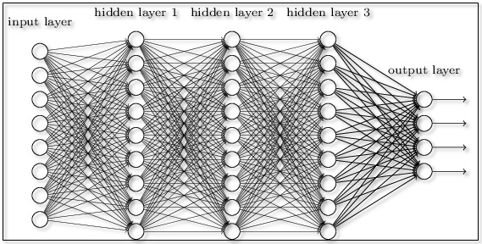
Goal of this thesis
y (output)
Rules/ Constraint
model
(W)
Enforcing output constraint to
Provide more logical output,
Improve the model performance,
Overcome the data deficiency problem.
x (Input )
Notes:
With these characteristics in mind, we hope to achieve

Slide 9
Challenges
It is hard to enforce output constraints on neural models.
Black box: no explicit relation between model parameters & output
Rules/ Constraint
model
?
x (Input )
y (output)

Slide 10
Challenges
It is hard to enforce output constraints on neural models.
Black box: no explicit relation between model parameters & output
Constraint is not explicit in training data.
Consider general classification problems.
Training set only consists of constraint-satisfying instances.
O
O
O
?
X
X
Notes:
We are mostly learning from supervised loss from labeled training set.

Slide 11
Challenges
It is hard to enforce output constraints on neural models.
Black box: no explicit relation between model parameters & output
Constraint is not explicit in training data.
Thus, constraint is a prior knowledge that we have to inject.

Slide 12
Overall approach
Inject prior knowledge in the form of a scoring function.
Constraint function measures the degree of violation.
Enforcing constraints in a model-agnostic way.
For the usability in general ML applications.
For the approach to be useful as neural models improve.
Rules/ Constraint
Notes:
It is difficult to build specific models with prior information per task and constraint.
For applied machine learning practitioners to
inject their knowledge without needing to design completely new model.
model-structure specific approaches may not last long.

Slide 13
Roadmap
Introduction.
Applications.
Inference with constraints. (Ch.3) [Lee, Mehta, Wick, Tristan, Carbonell AAAI19]
Learning with constraints. (Ch.4) [Mehta*, Lee*, Carbonell EMNLP18]
Agreement as constraint. (Ch.5) [Lim*, Lee*, Carbonell, Poibeau AAAI20]
* co-first authorship with equal contribution.
Notes:
✅☑️✔☑✔

Slide 14
Roadmap
☑ Introduction.
Applications.
Inference with constraints. (Ch.3) [Lee, Mehta, Wick, Tristan, Carbonell AAAI19]
Learning with constraints. (Ch.4) [Mehta*, Lee*, Carbonell EMNLP18]
Agreement as constraint. (Ch.5) [Lim*, Lee*, Carbonell, Poibeau AAAI20]
* co-first authorship with equal contribution.
Notes:
✅☑️✔☑✔

Slide 15
Syntactic parsing (sequence-to-sequence)
Syntactic Parsing
Finding structure of the provided (input) sentence.
Parser
John has a dog
True output:
(S (NP xx) (VP xx(NP xx xx) ) )
Notes:
Open, close are ”balanced” and
Input tokens being “preserved”

Slide 16
Syntactic parsing (sequence-to-sequence)
Syntactic Parsing
Finding structure of the provided (input) sentence.
Parser
John has a dog
True output:
(S (NP xx) (VP xx(NP xx xx) ) )
S
VP
NP
has
NP
John
a
dog
Notes:
The paranthesis opening, closing are ”balanced” and
Input tokens being “preserved”.
number of input tokens should match number of xx on the right.

Slide 17
Syntactic parsing (sequence-to-sequence)
Syntactic Parsing
Finding structure of the provided (input) sentence.
Parser
John has a dog
True output:
(S (NP xx) (VP xx(NP xx xx) ) )
Others possible output:
(S (NP xx) (VP xx (NP xx xx) ) ) ) )
( (S (NP xx) (VP xx (NP xx xx) )
(S (NP xx) ) )(VP xx (NP xx xx) ) )
(S (NP xx xx xx xx xx) )
(S (NP xx) (VP xx xx xx) )
Notes:
The paranthesis opening, closing are ”balanced” and
Input tokens being “preserved”
number of input tokens should match number of xx on the right.

Slide 18
Syntactic parsing (sequence-to-sequence)
Syntactic Parsing
Finding structure of the provided (input) sentence.
Parser
John has a dog
True output:
(S (NP xx) (VP xx(NP xx xx) ) )
Constraint:
“# open - # closing bracket = 0”
“# of input tokens has to match # of children on the tree”
Others possible output:
(S (NP xx) (VP xx (NP xx xx) ) ) ) )
( (S (NP xx) (VP xx (NP xx xx) )
(S (NP xx) ) )(VP xx (NP xx xx) ) )
(S (NP xx xx xx xx xx))
(S (NP xx) (VP xx xx xx))
Notes:
The syntactic parsing case is one of the real applications I worked on with output constraints .
Open, close are ”balanced” and
Input tokens being “preserved”
"John has a dog " has
For the sake of time and clarity,
The main application that I will focus on this talk will be on Semantic Role Labeling.

Slide 19
Semantic Role Labeling
Semantic Role Labeling (SRL)
Given verb predicate and a sentence, answers who, what, where, when, why, how (5W1H)
John broke the window with a hammer .
X (Input )
SRL model
Actor Verb Patient Patient. NA Tool Tool NA Predicate
Y (output)
Notes:
SRL is a problem of labeling a span. This requires, two subtasks 1. ...
such as "the window" as one span
and "a hammer" as another span.
2 ..
Many neural models solve this jointly.
but, let's revisit the traditional way of solving SRL to discuss syntactic constraints

Slide 20
Semantic Role Labeling
SRL can be viewed as a “span labeling” problem.
John broke the window with a hammer .
X (Input )
SRL model
Actor Verb Patient Patient. NA Tool Tool NA Predicate
Y (output)
Notes:
SRL is a problem of labeling a span. This requires, 1. & 2.
such as "the window" as one span
and "a hammer" as another span.
Many neural models solve this jointly.
but, let's revisit the traditional way of solving SRL..

Slide 21
Semantic Role Labeling
SRL can be viewed as a “span labeling” problem.
“Span” identification (Span= sequence of words.)
John broke the window with a hammer .
(John) (broke) (the window) with (a hammer) .
X (Input )
SRL model
Actor Verb Patient Patient. NA Tool Tool NA Predicate
Y (output)
Notes:
SRL is a problem of labeling a span. This requires, 1. & 2.
such as "the window" as one span
and "a hammer" as another span.
Many neural models solve this jointly.
but, let's revisit the traditional way of solving SRL..

Slide 22
Semantic Role Labeling
SRL can be viewed as a “span labeling” problem.
“Span” identification (Span= sequence of words.)
“Labeling” of provided span.
Many neural models solve the two jointly.
(John) (broke) (the window) with (a hammer) .
X (Input )
SRL model
Actor Verb Patient Patient. NA Tool Tool NA Predicate
Y (output)
Notes:
SRL is a problem of labeling a span. This requires, 1. & 2.
such as "the window" as one span
and "a hammer" as another span.
Many neural models solve this jointly.
but, let's revisit the traditional way of solving SRL..

Slide 23
Syntactic constraint on SRL
Traditionally, SRL span candidates were limited by syntactic tree.
Notes:
Children and the subtrees are the only possible candidates.
Thus, the syntactic parse tree can provide constraint-satisfying set.

Slide 24
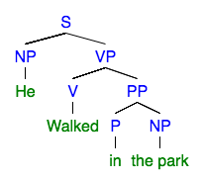
Syntactic constraint on SRL
Traditionally, SRL span candidates were limited by syntactic tree.
X (Input )
Possible span candidate
“He walked in the park”
(He), (walked),(in),(the park), (in the park),
(walked in the park), (He walked in the park)
Notes:
Children and the subtrees are the only possible candidates.
Thus, the syntactic parse tree can provide constraint-satisfying set.

Slide 25
Syntactic constraint on SRL
Traditionally, SRL span candidates were limited by syntactic tree.
X (Input )
Possible span candidate
“He walked in the park”
(He), (walked),(in),(the park), (in the park),
(walked in the park), (He walked in the park)
Constraint space
Constraint violating
If output has a span that is not on the constraint space
Notes:
Now from parse tree,
we can define "constraint space" for SRL output spans.
And define constraint violating when
output span of model is not in the "constraint space".
Now, we looked at the traditional approach, but then how about current neural models?

Slide 26
Syntactic constraint on SRL
How about neural SRL models?
X (Input )
In contrast, neural model without syntactic information can generate all possible “spans” given sentence.
“He walked in the park”

Slide 27
Syntactic constraint on SRL
How about neural SRL models?
Subset of all the possible output space
X (Input )
X (Input )
(He) (walked) (in the park)
(He) (walked in)(the park)
(He walked) (in the park)
(He walked in the)(park)
(He)(walked in the park)
(He walked in the park)
“He walked in the park”
In contrast, neural model without syntactic information can generate all possible “spans” given sentence.

Slide 28
Syntactic constraint on SRL
How about neural SRL models?
Subset of all the possible output space
X (Input )
(He) (walked) (in the park)
(He) (walked in)(the park)
(He walked) (in the park)
(He walked in the)(park)
(He)(walked in the park)
(He walked in the park)
“He walked in the park”
Possible span candidate
Comparing to the constraint space obtained from the parse tree.
(He), (walked),(in),(the park), (in the park),
(walked in the park), (He walked in the park)
Constraint space
Notes:
Now, while working better, as the neural model has the ability to output all possible spans

Slide 29
Syntactic constraint on SRL
How about neural SRL models?
Subset of all the possible output space
X (Input )
(He) (walked) (in the park)
(He) (walked in)(the park)
(He walked) (in the park)
(He walked in the)(park)
(He)(walked in the park)
(He walked in the park)
“He walked in the park”
Possible span candidate
Comparing to the constraint space obtained from the parse tree.
(He), (walked),(in),(the park), (in the park),
(walked in the park), (He walked in the park)
Constraint space
Notes:
Now, while working better, as the neural model has the ability to output all possible spans

Slide 30
Syntactic constraint on SRL
How about neural SRL models?
Subset of all the possible output space
X (Input )
(He) (walked) (in the park)
(He) (walked in)(the park)
(He walked) (in the park)
(He walked in the)(park)
(He)(walked in the park)
(He walked in the park)
“He walked in the park”
Possible span candidate
Comparing to the constraint space obtained from the parse tree.
(He), (walked),(in),(the park), (in the park),
(walked in the park), (He walked in the park)
Constraint space
Notes:
Now, while working better, as the neural model has the ability to output all possible spans

Slide 31
Syntactic constraint on SRL
How about neural SRL models?
Subset of all the possible output space
X (Input )
(He) (walked) (in the park)
(He) (walked in)(the park)
(He walked) (in the park)
(He walked in the)(park)
(He)(walked in the park)
(He walked in the park)
“He walked in the park”
Possible span candidate
Comparing to the constraint space obtained from the parse tree.
(He), (walked),(in),(the park), (in the park),
(walked in the park), (He walked in the park)
Constraint space
Notes:
Now, while working better, as the neural model has the ability to output all possible spans

Slide 32
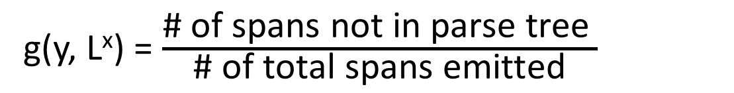
Constraint function on SRL.
Rules/ Constraint
Measuring degree of constraint violation.
g(y, L^{x}) as normalized error counts.
g(y, L^{x})
0.0
0.33
0.5
1.0
0.0
0.0
Subset of all the possible output space
(He) (walked) (in the park)
(He) (walked in)(the park)
(He walked) (in the park)
(He walked in the)(park)
(He)(walked in the park)
(He walked in the park)
g(y, L^{x}) = $\frac{\text{\# }\text{of} \text{spans} \text{not} \text{in} \text{parse} \text{tree} }{\text{\#} \text{of} \text{total} \text{spans} \text{emitted}}$
Notes:
As we discussed, the constraint rules are that
Notice two things.
1) that g=0 represents constraint satisfaction.
2)
The whole sentence is a constarint-satisfying output
but not necessarily "true" output.
Enforcing constraint is important,
but there are trivial answers which we may want to avoid.

Slide 33
Summary of constraint types
Task | model | Source of constraint | Checking constraint
Syntactic Parsing | seq2seq | input-output relation + output-only | Count comparison
SRL | Sequence tagger | Exterior knowledge | Existence in constraint space
How can we enforce constraints to neural models ?

Slide 34
Roadmap
☑ Introduction.
☑ Applications.
Inference with constraints. (Ch.3) [Lee, Mehta, Wick, Tristan, Carbonell AAAI19] [Lee, Wick, Tristan, Carbonell AKBC17]
Learning with constraints. (Ch.4) [Mehta*, Lee*, Carbonell EMNLP18]
Agreement as constraint. (Ch.5) [Lim*, Lee*, Carbonell, Poibeau AAAI20]
* co-first authorship with equal contribution.
Notes:
✅☑️✔☑✔

Slide 35
Roadmap
☑ Introduction.
☑ Applications.
Inference with constraints. (Ch.3) [Lee, Mehta, Wick, Tristan, Carbonell AAAI19] [Lee, Wick, Tristan, Carbonell AKBC17]
Learning with constraints. (Ch.4) [Mehta*, Lee*, Carbonell EMNLP18]
Agreement as constraint. (Ch.5) [Lim*, Lee*, Carbonell, Poibeau AAAI20]
* co-first authorship with equal contribution.
Notes:
✅☑️✔☑✔

Slide 36
Overview for “Inference with constraints”
Can we enforce global constraints in the inference process without searching exponential space ?
Proposed method
Gradient-Based Inference (GBI).
Updating model parameter to search constraint-satisfying output.
Take away
Constraint violation signal can guide the model weight updates.
Leading to better & faster results to competing method.

Slide 37
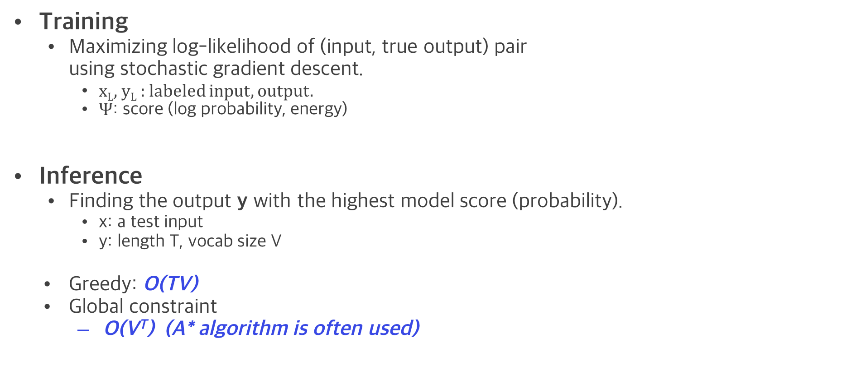
Training & Inference of a neural model
y (output)
model
(W)
Training
Maximizing log-likelihood of (input, true output) pair using stochastic gradient descent.
x_{L}, y_{L} : labeled input, output.
$Ψ$: score (log probability, energy)
Inference
Finding the output y with the highest model score (probability).
x: a test input
y: length T, vocab size V
Greedy: O(TV)
Global constraint
O(V^{T}) (A* algorithm is often used)
x (Input )
Notes:
Training optimizes over W: model para

Slide 38
Training & Inference of a neural model
y (output)
model
(W)
Training
Maximizing log-likelihood of (input, true output) pair using stochastic gradient descent.
x_{L}, y_{L} : labeled input, output.
$Ψ$: score (log probability, energy)
Inference
Finding the output y with the highest model score (probability).
x: a test input
y: length T, vocab size V
Greedy: O(TV)
Global constraint
O(V^{T}) (A* algorithm is often used)
Learned model
x (Input )
Notes:
Let’s discuss “inference” of sequence output Y in general for a moment.

Slide 39
Gradient-Based Inference (GBI)
y (output)
model
(W)
Training
Maximizing log-likelihood of (input, true output) pair using stochastic gradient descent.
x_{L}, y_{L} : labeled input, output.
$Ψ$: score (log probability, energy)
Inference
Finding the output y with the highest model score (probability).
x: a test input
y: length T, vocab size V
Greedy: O(TV)
Global constraint
O(V^{T}) (A* algorithm is often used)
Learned model
x (Input )

Slide 40
Gradient-Based Inference (GBI)
y (output)
model
(W)
Training
Maximizing log-likelihood of (input, true output) pair using stochastic gradient descent.
x_{L}, y_{L} : labeled input, output.
$Ψ$: score (log probability, energy)
Inference
Finding the output y with the highest model score (probability).
x: a test input
y: length T, vocab size V
Greedy: O(TV)
Global constraint
O(V^{T}) (A* algorithm is often used)
Post-processing is often used instead:
Get multiple candidates and filter out constraint-violating candidates.
Learned model
x (Input )
Notes:
black box,
because not much of particular modification to the model, Can we update the model parameter to find constraint-satisfying output?
besides input, output representation changes happen in typical neural network training.

Slide 41
Gradient-Based Inference (GBI)
y (output)
model
(W)
Training
Maximizing log-likelihood of (input, true output) pair using stochastic gradient descent.
x_{L}, y_{L} : labeled input, output.
$Ψ$: score (log probability, energy)
Inference
Finding the output y with the highest model score (probability).
x: a test input
y: length T, vocab size V
Greedy: O(TV)
Global constraint
O(V^{T}) (A* algorithm is often used)
Can we do “continuous space” search
to find constraint-satisfying output y?
(like Training)
x (Input )
Notes:
We have very good continuous space search environment.
(with stochastic gradient updates )
And the model architectures are also built to this continuous search in efficient manner.

Slide 42
Key Idea for the method
Deterministic y given fixed W, x.
Model parameter W is in continuous space.
Computational architectures for easy gradient updates.
Can we nudge the model parameter W
to find constraint-satisfying output y?
Notes:
Deterministic y given "greedy inference" (which is cheap)

Slide 43
Key Idea for the method
All possible output space
Can we find constraint-satisfying output
by updating the model parameter ?
Constrained space
Notes:
If we can create a loss function to decrease the “cosntraint violation”,
Could we perhaps get the constraint satisfying output more efficiently?

Slide 44
Key Idea for the method
All possible output space
Can we find constraint-satisfying output
by updating the model parameter ?
Constrained space
Notes:
“A loss function that reflects to reduce the cosntraint”

Slide 45
Key Idea for the method
All possible output space
Can we find constraint-satisfying output
by updating the model parameter ?
Constrained space
Notes:
“A loss function that reflects to reduce the cosntraint”

Slide 46
Key Idea for the method
All possible output space
Can we find constraint-satisfying output
by updating the model parameter ?
Constrained space
Notes:
Note that X is fixed
And we are optimizing over W (in the hope of getting the y hat that satisfies the constraint)

Slide 47
Key Idea for the method
All possible output space
Can we find constraint-satisfying output
by updating the model parameter ?
…
Constrained space
Notes:
Now how do we do it?
What kind of loss function would drive to accomplish this?
(next slide)
I propose to use the constraint function that I introduced earleier.

Slide 48
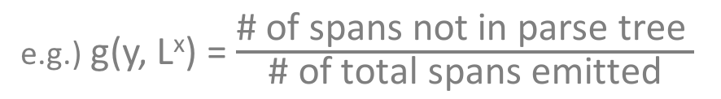
Key Idea for the method
All possible output space
Can we find constraint-satisfying output
by updating the model parameter ?
…
Constrained space
Likelihood
Constraint function
e.g.) g(y, L^{x}) = $\frac{\text{\# }\text{of} \text{spans} \text{not} \text{in} \text{parse} \text{tree} }{\text{\#} \text{of} \text{total} \text{spans} \text{emitted}}$
Notes:
Which denotes Degree of constraint violation
Or how far the output $y$ is from the constrained space.
(next slide) Definition of score function

Slide 49
Key Idea for the method
All possible output space
Can we find constraint-satisfying output
by updating the model parameter ?
…
Constrained space
Expected constraint violation
Notes:
Moving toward constrained space
by moving away from the “observed” constraint-violating outputs

Slide 50
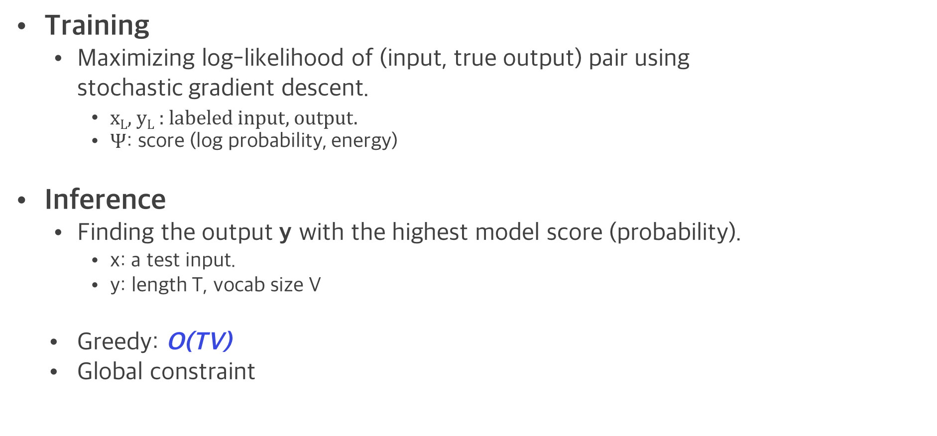
Gradient-Based Inference (GBI)
y (output)
model
(W)
Training
Maximizing log-likelihood of (input, true output) pair using stochastic gradient descent.
x_{L}, y_{L} : labeled input, output.
$Ψ$: score (log probability, energy)
Inference
Finding the output y with the highest model score (probability).
x: a test input.
y: length T, vocab size V
Greedy: O(TV)
Global constraint
Can we do “continuous space” search
to find constraint-satisfying output y?
(like Training)
Learned model
x (Input )

Slide 51
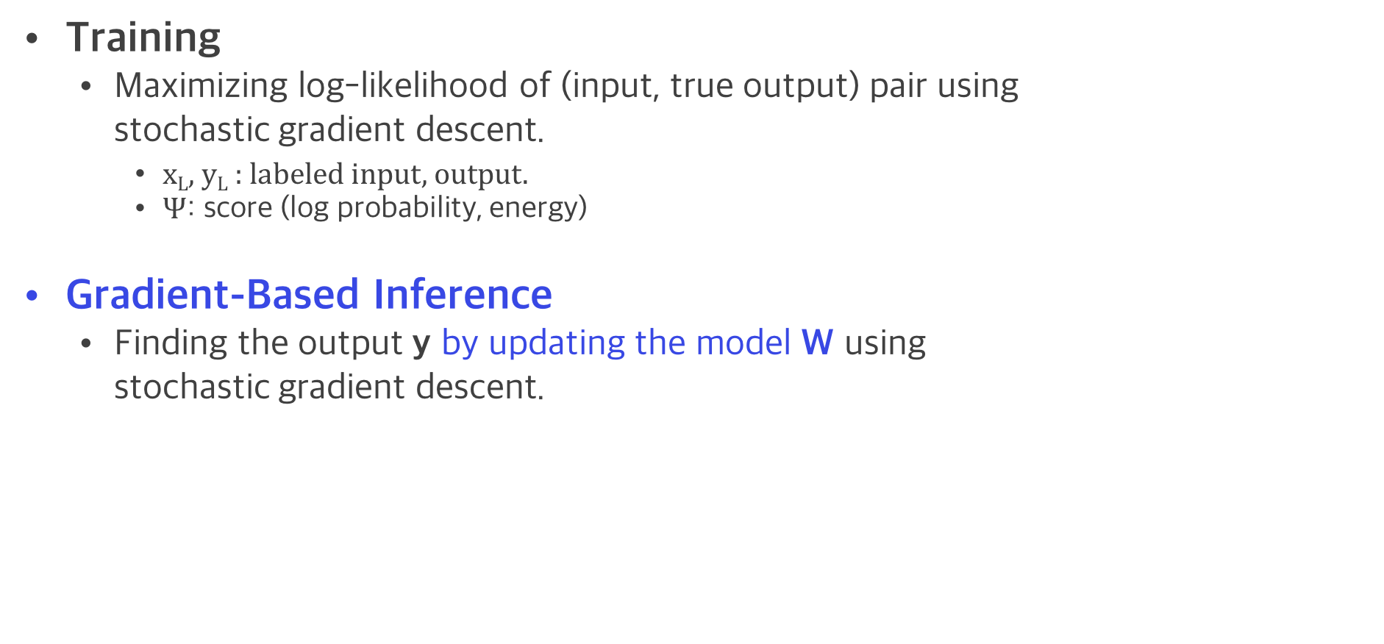
Gradient-Based Inference (GBI)
y (output)
model
(W)
Training
Maximizing log-likelihood of (input, true output) pair using stochastic gradient descent.
x_{L}, y_{L} : labeled input, output.
$Ψ$: score (log probability, energy)
Gradient-Based Inference
Finding the output y by updating the model W using stochastic gradient descent.
x (Input )
Notes:
Alternating min, max fashion.

Slide 52
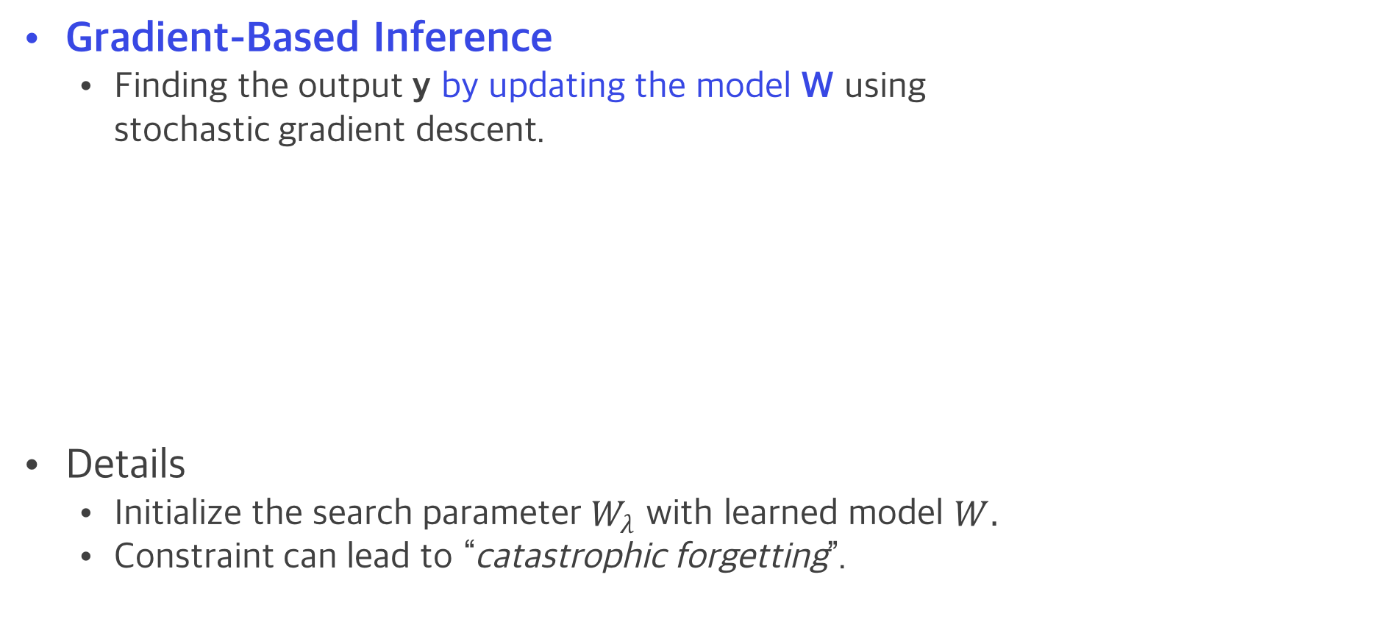
Gradient-Based Inference (GBI)
y (output)
model
(W)
Gradient-Based Inference
Finding the output y by updating the model W using stochastic gradient descent.
Details
Initialize the search parameter $W_{λ}$ with learned model $W.$
Constraint can lead to “catastrophic forgetting”.
Learned model
Regularizer
x (Input )
Notes:
For example, a trivial constraint satisfaction is just having whole sentence as a span in case of SRL.
Alternating min, max fashion.

Slide 53
Gradient-Based Inference (GBI)
y (output)
model
(W)
Gradient-Based Inference
Finding the output y by updating the model W using stochastic gradient descent.
Details
Initialize the search parameter $W_{λ}$ with learned model $W.$
Constraint can lead to “catastrophic forgetting”.
x (Input )
Notes:
Alternating min, max fashion.

Slide 54
Comparison of complexity
Greedy inference: O(TV)
1st-order inference: O(TV²), e.g. Viterbi decoding
Combinatorial search O(V^{T})
GBI iteratively updates model parameter with simple inference.
Update model parameter: O(TLh²)
L: number of layers, h: representation size
e.g. SRL model with (T=7, V=130, h=100, L=10)

Slide 55
Comparison of complexity
Greedy inference: O(TV) ~ 900
1st-order inference: O(TV²) ~ 1E+5
Combinatorial search O(V^{T}) ~ 6E+14
GBI iteratively updates model parameter with simple inference.
Update model parameter: O(TLh²) ~ 7E+5 O(TV²) ~ 1E+5
L: number of layers, h: representation size
e.g. SRL model with (T=7, V=130, h=100, L=10)
Notes:
Recall
Can we have some loss function
to nudge the model parameter W
to search for constraint-satisfying output.
If we can create a loss function to decrease the “cosntraint violation” as we would in training
"then"
Could we perhaps get the constraint satisfying output more efficiently than the exponential search?
Again, the basis of this thought was ...
Typical complexity of RNN forward propagation is O(tLh^2) for length t, number of layers L, and representation size h.
Backpropagation is the same.
L =10 h= 256^2 layer

Slide 56
Experiments on SRL
OntoNotes v5.0^{[1]}, CoNLL-2012 shared task (278k train, 38.3k dev, 25.6k test)
Baseline architecture
multi-layer highway bi-directional LSTM (ELMo embedding)^{[2],[3]}
Compared GBI with baseline and A* as used in He et al^{[2]}.
[1] Predhan et al., Towards Robust Linguistic Analysis using OntoNotes, CoNLL2013
[2] He et al., Deep Semantic Role Labeling: What Works and What’s Next, ACL 2017
[3] Peters et al., Deep contextualized word representations, NAACL 2018
Notes:
Show the overall result first.
왜 inconsistent한가?

Slide 57
GBI enforces constraint + improves F1
System Performance
(F1 score)
Enforcing constraint
(Conversion rate %)
SRL experiment result on CoNLL-2012
Notes:
Show the overall result first.

Slide 58
Effect of baseline model
GBI enforces constraint 42%-52% of the time.
Enforces constraints without hurting the overall system.
More gains on the lower-resource model.
SRL x : SRL system trained on x % data.
Notes:
2.7 → 1.2
Is it because GBI does not work as well on the high-performing models? If we look at it more closer,
We can help more on the low-resource because GBI only affects constraint failing outputs.

Slide 59
Speed experiment (SRL)
Verified that GBI is faster than the A* (and better performance as seen before)

Slide 60
GBI was tested on
Three applications
Sequence tagging model: SRL
Sequence-to-Sequence model: Toy transducer, Syntactic parsing
Toy transducer
Constituency Parsing
SRL
Notes:
SRL(10.6-11.7F1 imporved, 42.3%-52.8% converted)
Transducer, (+7.2 %, 65% of constraint violation resolved)
Parsing( +0.9~6.14 F1 imporved, 70-94% converted)

Slide 61
Conclusions on Inference with Constraints
Enforce global constraints in the inference
using gradient signals from “constraint violations”.
GBI is especially helpful
on low-resource,
on out-of-domain data,
when constraint is noisy.
…
Thesis goals
✔ Provide more logical output,
✔ Improve the model performance,
✔ Overcome the data deficiency problem.
Constrained space

Slide 62
Related Work
Use of finite state automatons^{[1]}
Dealt with similar constraint in syntactic parsing.
To reshape the probability distribution at each decoding step.
New constraint injection work on learning time.
Key idea: Differentiable constraint loss using soft logic.
Applying this constraint loss for continuous space search.
[1] Deutsch et. al, General-purpose algorithm for constrained sequential inference. CoNLL 2019

Slide 63
Roadmap
☑ Introduction.
☑ Applications.
☑ Inference with constraints. (Ch.3) [Lee, Mehta, Wick, Tristan, Carbonell AAAI19]
Learning with constraints. (Ch.4) [Mehta*, Lee*, Carbonell EMNLP18]
Agreement as constraint. (Ch.5) [Lim*, Lee*, Carbonell, Poibeau AAAI20]
* co-first authorship with equal contribution.
Notes:
✅☑️✔☑✔

Slide 64
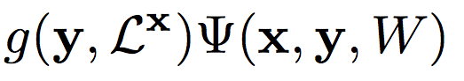
Learning with constraints?
y (output)
Knowledge/ Constraint
model
(W)
GBI: injecting constraint in the inference.
Model parameter update per input instance x.
Can we use the same update rule to inject constraint in train time?
Knowledge/ Constraint
x (Input )
Notes:
And embed it to the model.

Slide 65
Learning with constraints?
GBI: injecting constraint in the inference.
Model parameter update per input instance x.
Can we use the same update rule to inject constraint in train time?
Questions:
Would the previous loss function be useful as is?
Note that constraint is not the main objective of the task.
What kind of regularizer can be used in learning time?
Ranzanto et al., Sequence Level Training with Recurrent Neural Networks, ICLR16
Notes:
And embed it to the model.

Slide 66
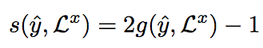
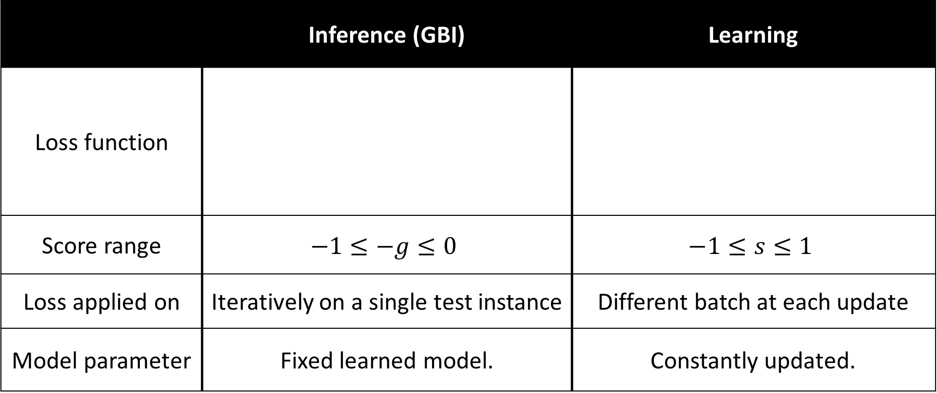
Comparison of inference & learning
 | Inference (GBI) | Learning
Loss function
Score range | $$−1≤−g≤0$$ | $$−1≤s≤1$$
Loss applied on | Iteratively on a single test instance | Different batch at each update
Model parameter | Fixed learned model. | Constantly updated.
Notes:
Now moving from the top
So whereas GBI only penalizes,
This learning enables promotion of examples as well.

Slide 67
Overview for “learning with constraints”
Can we use how well the model satisfies the constraint as a signal to learn further?
Proposed method
Proposing three variant loss functions using constraint information.
Semi-supervised Learning loss to help low-resource setting.
Take away
Semi-supervised learning shows significant help on low-resource as well as on large resource.
Notes:
Gold parse has about 10% disagreement with gold SRL
And
System parse has about 20% disagreement with gold SRL.
B100 84.4
J100 84.75 → J100 + GBI 85.87
J100-SSL 84.87

Slide 68
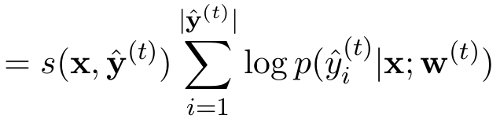
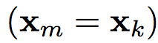
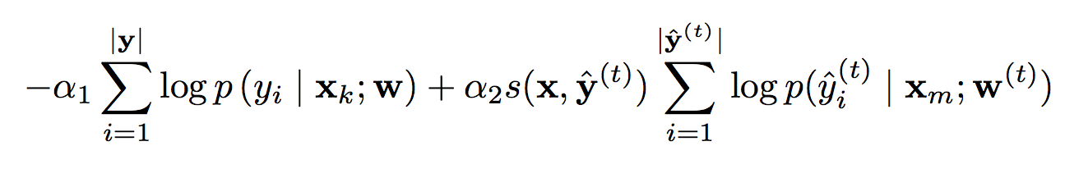
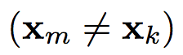
Types of loss functions
Enforcing constraints with the reward s(y,L^{x})
Constraint loss (c-loss)
SRL-labeled data
SRL-labeled data
SRL-labeled data
SRL-labeled data
SRL-labeled data
SRL-labeled data
SRL-labeled data
SRL-labeled data
SRL-labeled data
SRL-labeled data
SRL-labeled data
SRL-unlabeled data
SRL-unlabeled data
SRL-labeled data
SRL-unlabeled data
SRL-labeled data
SRL-unlabeled data
SRL-labeled data
SRL-unlabeled data
SRL-labeled data
SRL-unlabeled data
SRL-labeled data
SRL-unlabeled data
SRL-labeled data
SRL-unlabeled data
SRL-labeled data
SRL-unlabeled data
Notes:
Throw in some neural network equations h_t = f(W*x_t)

Slide 69
Types of loss functions
Enforcing constraints with the reward s(y,L^{x})
Constraint loss (c-loss)
Joint loss
SRL-labeled data
SRL-labeled data
SRL-labeled data
SRL-labeled data
SRL-labeled data
SRL-labeled data
SRL-labeled data
SRL-labeled data
SRL-labeled data
SRL-labeled data
SRL-labeled data
SRL-unlabeled data
SRL-unlabeled data
SRL-labeled data
SRL-unlabeled data
SRL-labeled data
SRL-unlabeled data
SRL-labeled data
SRL-unlabeled data
SRL-labeled data
SRL-unlabeled data
SRL-labeled data
SRL-unlabeled data
SRL-labeled data
SRL-unlabeled data
SRL-labeled data
SRL-unlabeled data
Notes:
Figuratively speaking,

Slide 70
Types of loss functions
Enforcing constraints with the reward s(y,L^{x})
Constraint loss (c-loss)
Joint loss
Unlabeled
Constraint
(B_{label}=B_{c})
Labeled
Constraint
SRL-labeled data
SRL-labeled data
SRL-labeled data
SRL-labeled data
SRL-labeled data
SRL-labeled data
SRL-labeled data
SRL-labeled data
SRL-labeled data
SRL-labeled data
SRL-labeled data
SRL-unlabeled data
SRL-unlabeled data
SRL-labeled data
SRL-unlabeled data
SRL-labeled data
SRL-unlabeled data
SRL-labeled data
SRL-unlabeled data
SRL-labeled data
SRL-unlabeled data
SRL-labeled data
SRL-unlabeled data
SRL-labeled data
SRL-unlabeled data
SRL-labeled data
SRL-unlabeled data
Notes:
Joint loss is defined on the labeled data to learn constraints.
Note that the c-loss does not require any labeled data to learn constraints,
But if we draw x_m from unlabeled dataset, ( we can actually make it

Slide 71
Types of loss functions
Enforcing constraints with the reward s(y,L^{x})
Constraint loss (c-loss)
Joint loss
Semi-supervised (SSL)
Unlabeled
Labeled
Chang, Ratinov, & Roth,
Structured learning with constrained conditional models, 2008
Constraint
SRL-labeled data
SRL-labeled data
SRL-labeled data
SRL-labeled data
SRL-labeled data
SRL-labeled data
SRL-labeled data
SRL-labeled data
SRL-labeled data
SRL-labeled data
SRL-labeled data
SRL-unlabeled data
SRL-unlabeled data
SRL-labeled data
SRL-unlabeled data
SRL-labeled data
SRL-unlabeled data
SRL-labeled data
SRL-unlabeled data
SRL-labeled data
SRL-unlabeled data
SRL-labeled data
SRL-unlabeled data
SRL-labeled data
SRL-unlabeled data
SRL-labeled data
SRL-unlabeled data
Notes:
Throw in some neural network equations h_t = f(W*x_t)
co-training

Slide 72
Types of loss functions
Enforcing constraints with the reward s(y,L^{x})
Constraint loss (c-loss)
Joint loss
Semi-supervised (SSL)
(B_{label}=B_{c})
SRL-labeled data
SRL-labeled data
SRL-labeled data
SRL-labeled data
SRL-labeled data
SRL-labeled data
SRL-labeled data
SRL-labeled data
SRL-labeled data
SRL-labeled data
SRL-labeled data
SRL-unlabeled data
SRL-unlabeled data
SRL-labeled data
SRL-unlabeled data
SRL-labeled data
SRL-unlabeled data
SRL-labeled data
SRL-unlabeled data
SRL-labeled data
SRL-unlabeled data
SRL-labeled data
SRL-unlabeled data
SRL-labeled data
SRL-unlabeled data
SRL-labeled data
SRL-unlabeled data
Notes:
Throw in some neural network equations h_t = f(W*x_t)

Slide 73
SRL experiment
OntoNotes v5.0^{[1]}, CoNLL-2012 shared task (278k train, 38.3k dev, 25.6k test)
The same experiment setup with GBI
Using 1%, 10% of training set to represent lower resource setting.
Using full resource as well.
[1] Predhan et al., Towards Robust Linguistic Analysis using OntoNotes, CoNLL2013
Notes:
Show the overall result first.
왜 inconsistent한가?

Slide 74
Comparison of losses (on 1% training)
Micro cross entropy*
Fine-tuning with the same learning rate as the c-loss
With cross entropy.
Notes:
To validate c-loss is not just some noise,
We also compared with further training with cross-entropy using the same small leraning rate which I call “micro”-cross entropy.

Slide 75
Comparison of losses (on 1% training)
Avg. Violation
We scored proportion of violation per instance and averaged it across.
Notes:
Throw in some neural network equations h_t = f(W*x_t)

Slide 76
Learning from
extra data really helps
Comparison of losses (on 1% training)
Notes:
Throw in some neural network equations h_t = f(W*x_t)

Slide 77
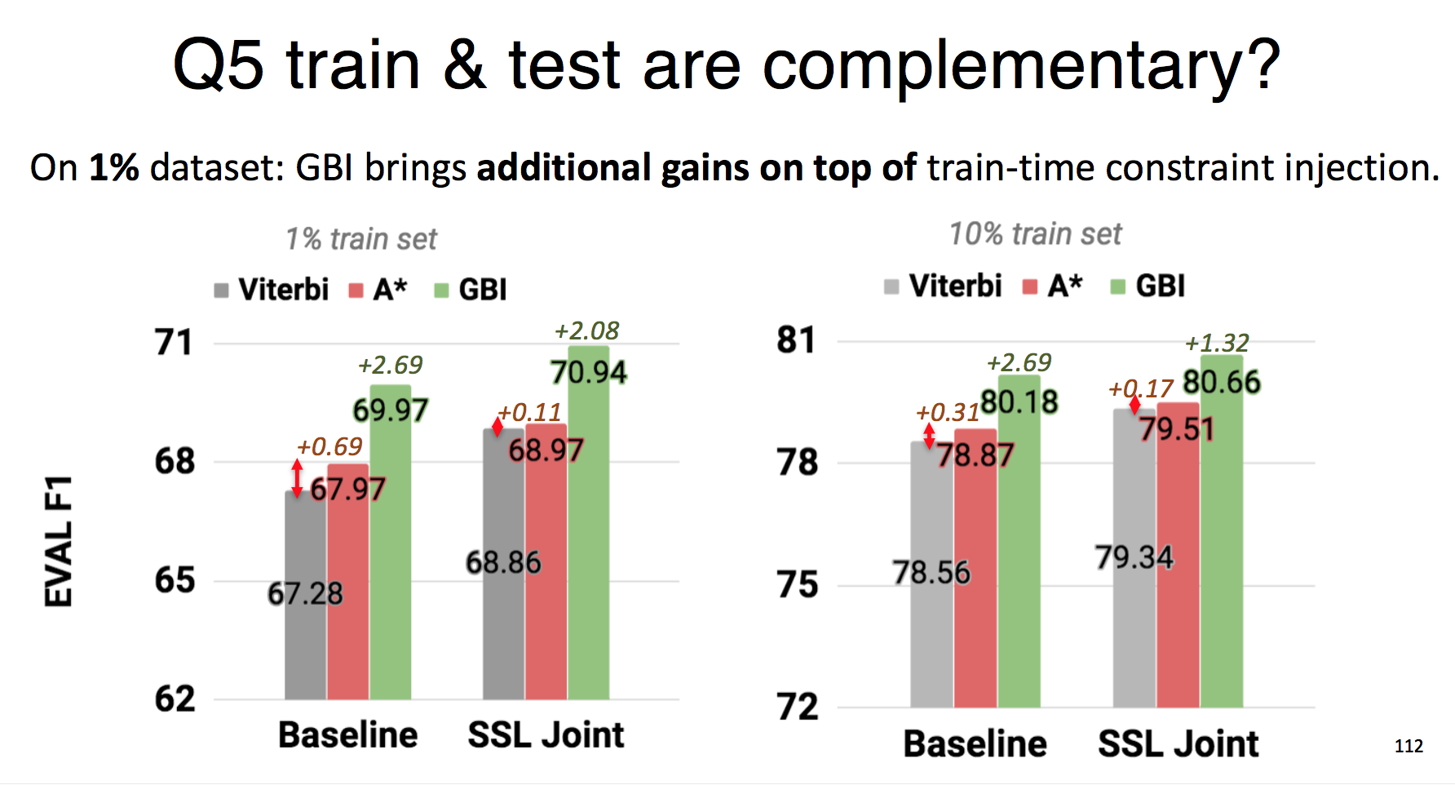
Q) Is inference with constraint still useful?
Plain supervised learning
Learning with constraint
Plain supervised learning
Learning with constraint
Notes:
Applied GBI on top of Baseline vs. SSL Joint

Slide 78
Conclusions on Learning with Constraints
Constraint information enabled training with unlabeled data.
SSL with constraint is
Especially on lower-resource
Also significant in high-resource
Complementary with GBI as well.
Unlabeled
Labeled
Constraint
Thesis goals
✔ Provide more logical output,
✔ Improve the model performance,
✔ Overcome the data deficiency problem.

Slide 79
Related work
Modeling SRL with syntactic information.
Multi-task learning. (Swabha et al., 2018^{[1]})
Guiding attention with dependency parse tree. (Strubell et al. 2018^{[2]})
Model-agnostic approach
Differentiable constraint function using soft logic.
Dual decomposition (Nandwani et al. 2019^{[3]}) showed similar gains in SRL.
Regularizing the models away from inconsistency (Li et al., 2019^{[4]})
Structured Tuning for Semantic Role Labeling (Li et al., 2019^{[5]})
[1] Swayamdipta et al., Syntactic Scaffolds for Semantic Structures, EMNLP 18
[2] Strubell et al., Linguistically-Informed Self-Attention for Semantic Role Labeling, EMNLP18
[3] Nandwani et al., A Primal-Dual Formulation for Deep Learning with Constraints, NeurIPS 2019
[4] Li et al., A Logic-Driven Framework for Consistency of Neural Models, EMNLP 2019
[5] Li et al., Structured Tuning for Semantic Role Labeling, ACL 2020
Notes:
While they are not directly comparable as using different architecture and so on,
All showed that syntactic information really helps to learn better model.
There has been a lot of exciting work.

Slide 80
Roadmap
☑ Introduction.
☑ Applications.
☑ Inference with constraints. (Ch.3) [Lee, Mehta, Wick, Tristan, Carbonell AAAI19]
☑ Learning with constraints. (Ch.4) [Mehta*, Lee*, Carbonell EMNLP18]
Agreement as constraint. (Ch.5) [Lim*, Lee*, Carbonell, Poibeau AAAI20]
Notes:
✅☑️✔☑✔

Slide 81
Other ways of using SSL with constraint
Consider the classic semi-supervised learning methods that used unlabeled dataset.
Many work have used multi-view learning to use unlabeled dataset.
Co-training^{[1]}, co-regularization^{[2]} and many others^{[3] [4]}.
[1] Blum and Mitchell, Combining labeled and un- labeled data with co-training, COLT 1998
[2] Sindhwani and Belkin, A co-regularization approach to semi-supervised learning with multiple views. In ICML 2005
[3] Muslea et al., Active+ semi-supervised learning= robust multi-view learning. ICML 2002.
[4] Yu et al., Bayesian Co-Training, JMLR 2011

Slide 82
Multi-view learning?
Multi-view means different representation (view) of the same data.
Can we enhance multi-view models by promoting agreement on the unlabeled data?
Data
(sentence)
Data
View1
Word
View2
Character
View3
ELMo, BERT ..

Slide 83
Overview for “Agreement as constraints”
Can we enhance multi-view models by promoting agreement on the unlabeled data?
Proposed method
Applying previous SSL method with agreement score across the views.
Take away
SSL significantly improves extremely low-resource setting.
SSL makes views to agree more on unlabeled data.
Data
(sentence)
Word
Character
ELMo, BERT ..
Notes:
We want to see whether we can promote coherence of multiple views,
By using agreement constraint on the unlabeled dataset.

Slide 84
Single-view vs. Multi-view
Labeled
corpus
sentences
word, char, POS
word
char
BiLSTM + MLP
BiLSTM + MLP
BiLSTM + MLP
Parser
classifier
classifier
Loss
Loss
Loss
9 out of top 10 results in CoNLL 2018 challenge uses concatenated feature representation with single view.
Zeman et al., CoNLL 2018 Shared Task: Multilingual Parsing from Raw Text to Universal Dependencies, CoNLL 2018
Notes:
The paper was inspired by the Co-Train like method,
so I named the method as Co-meta.
Why meta is there will be obvious in the next slide,
but before.

Slide 85
Meta-BiLSTM model
Bohnet et al., Morphosyntactic tagging with a meta-bilstm model over context sensitive token encodings, ACL18
Most of the model
Meta-base
Training
corpus
Training
corpus
Word
Char
word, char, POS
BiLSTM
BiLSTM
BiLSTM + MLP
(Meta) BiLSTM
Tagger1
Tagger2
classifier
Tagger3
Loss
Loss
Loss
Loss

Slide 86
Meta-BiLSTM + Semi-supervised model
Most of the model
Meta-base
Co-meta
Training
corpus
Unlabeled
corpus
Training
corpus
Word
Char
word, char, POS
BiLSTM
BiLSTM
BiLSTM + MLP
(Meta) BiLSTM
Tagger1
Tagger2
classifier
Tagger3
Loss
Supervised
Loss
Supervised
Loss
Supervised
Loss
Agreement score
Notes:
Co-meta inspired by Co-Train.

Slide 87
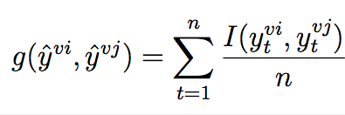
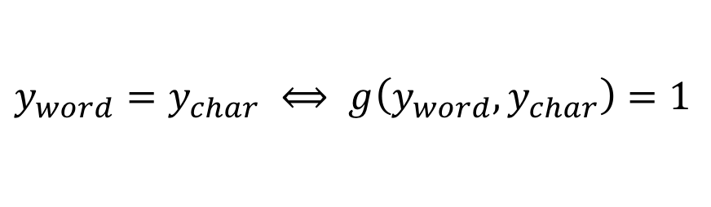
Meta-BiLSTM + Semi-supervised model
Co-meta
Training
corpus
Unlabeled
corpus
Word
Char
Agreement promotion:
BiLSTM
BiLSTM
$y_{word}=y_{char} ⟺ g\left(y_{word},y_{char}\right)=1$
(Meta) BiLSTM
Tagger1
Tagger2
Tagger3
Loss
Loss
Loss
Agreement constraint
[1] Kondratyuk, D. 2019. 75 languages, 1 model: Parsing universal dependencies universally

Slide 88
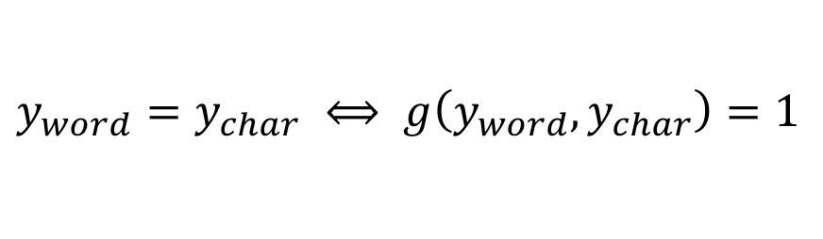
Comparison with previous chapters
Co-meta
Previous Chapters:
Checking output on the explicit rule
Training
corpus
Unlabeled
corpus
Word
Char
BiLSTM
BiLSTM
Agreement promotion:
Comparison of pair of output.
(Meta) BiLSTM
Tagger1
Tagger2
$y_{word}=y_{char} ⟺ g\left(y_{word},y_{char}\right)=1$
Tagger3
Loss
Loss
Loss
Agreement constraint
Co-meta was tested over 9 languages
on low-resource setting
Showing +2.1-9.3 LAS points
-0.7 (one exception Finnish)

Slide 89
Comparison with previous chapters
Co-meta
Previous Chapters:
Checking output on the explicit rule
Training
corpus
Unlabeled
corpus
Word
Char
BiLSTM
BiLSTM
Agreement promotion:
Comparison of pair of output.
(Meta) BiLSTM
Tagger1
Tagger2
$y_{word}=y_{char} ⟺ g\left(y_{word},y_{char}\right)=1$
Tagger3
Loss
Loss
Loss
Agreement constraint
Co-meta was tested over 9 languages
on low-resource setting
Showing +2.1-9.3 LAS points
-0.7 (one exception Finnish)

Slide 90
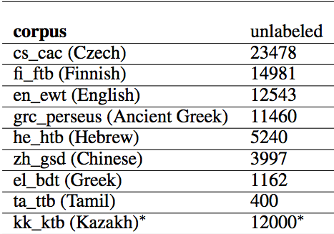
Experiment setup
Multi-task of dependency parsing & POS tagging.
LAS score for parsing, UPOS score for POS tagging
Using CoNLL2018 dataset.
Extremely low-resource setting (50 labeled sentences).
Plain texts in the same corpus.
Tested over 9 languages.

Slide 91
Experiment: comparison to baseline
50 labels
100 labels
Co-meta was tested over 9 languages
on low-resource setting
Showing +2.1-9.3 LAS points
-0.7 (one exception Finnish)

Slide 92
Experiment: Co-meta variant comparison

Slide 93
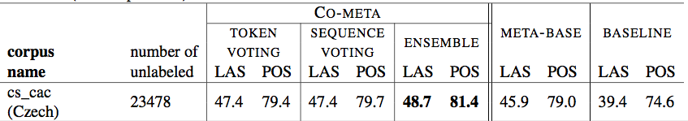
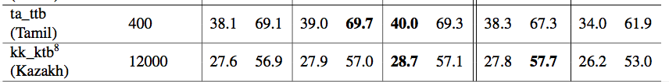
Experiment: Co-meta variant comparison
Which works the best depends on the language.
In average, ensemble works the best.
Co-meta was tested over 9 languages
on low-resource setting
Showing +2.1-9.3 LAS points
-0.7 (one exception Finnish)

Slide 94
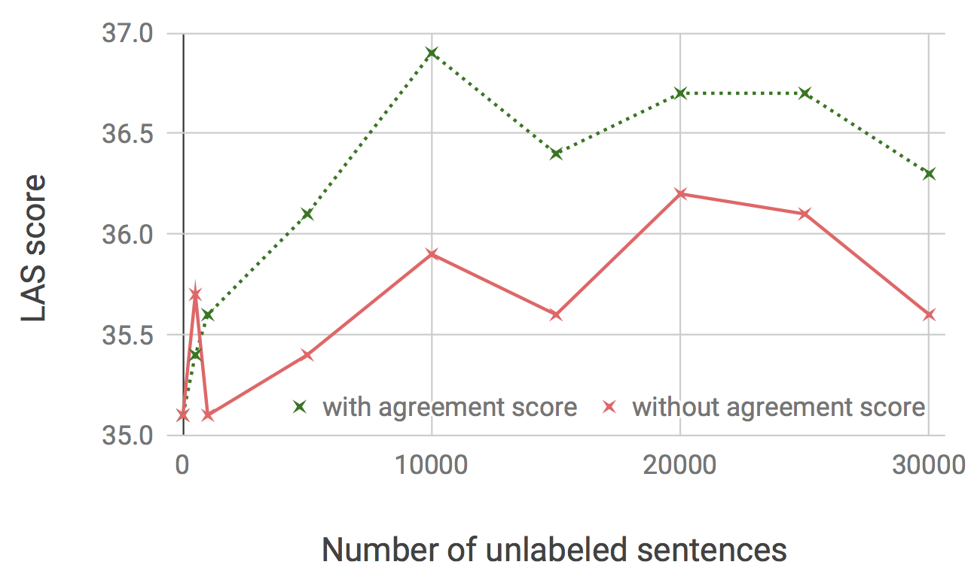
Effect of the agreement score
Without agreement score: simple self-training (red)
With agreement score: co-meta (green)
Notes:
Also observed negative cases.

Slide 95
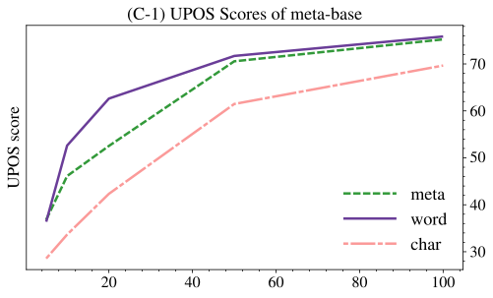
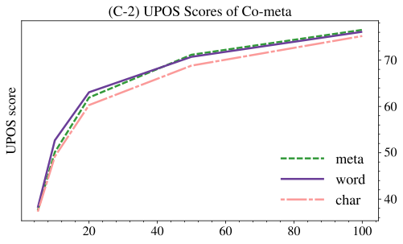
Effect of co-meta on agreement?
Ablation study done on Chinese with increasing training data
Meta-Base
(No use of unlabeled data)
Co-meta
(with agreement score)
Notes:
Fixed unlabeled data.

Slide 96
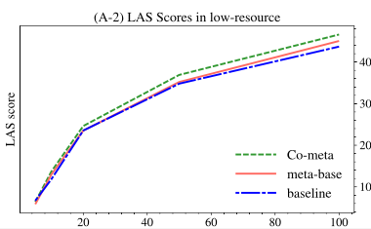
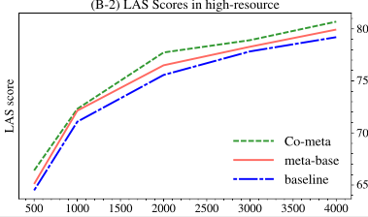
Increasing labels.
Co-meta (green) vs. Meta-base (orange) vs. Baseline (blue)
Co-meta outperforms all with
Notes:
Similar trend for UPOS
5, 10, 20, 50, 100 (left)
0.5k, 1k, 2k, 3k, 4k (right)

Slide 97
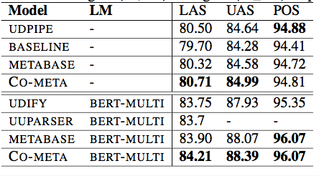
Extra view: ELMo, BERT
For English, marginal improvement over Meta-Base.
But, significant improvement over competing models.
(+1.02 LAS, 0.6 POS)
For Chinese, records the state-of-the-art
Training
corpus
Unlabeled
corpus
Extra View
Word
Char
Loss
Loss
Loss
Meta
Loss
Agreement constraint

Slide 98
Conclusion on SSL with agreement score
Agreement score can help multiple views co-learn each other on unlabeled data.
Co-meta
can help extremely low-resource,
can expand views
incorporate ELMo, BERT
Training
corpus
Unlabeled
corpus
Word
Char
Loss
Loss
Meta
Goals
✔ Improve the model performance,
✔ Overcome the data deficiency problem.
Loss
Agreement constraint
Notes:
no degradation on high-resource,
✅☑️✔☑✔

Slide 99
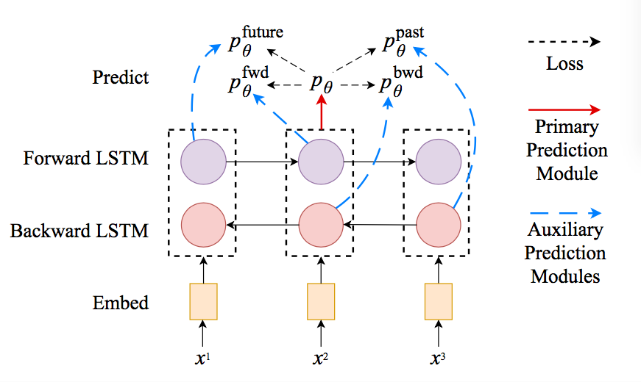
Related work
Cross-View Training (CVT)^{[1]}
Semi-supervised learning on multi-view learning
“Primary prediction” from full view [h→,h←] teaches “partial views” [h→] and [h←].
 | CVT | Co-meta
Technique | Token-level distillation | Sequence-level distillation with score
Direction of teaching | Primary → Auxiliary | Chooses what to learn from
Multi-view | Limit of time | Different feature, embeddings, structures
[1] Clark et al., Semi-Supervised Semantic Role Labeling with Cross-View Training, EMNLP18
Notes:
While they are not directly comparable as using different architecture and so on,
All showed that syntactic information really helps to learn better model.
There has been a lot of exciting work.

Slide 100
Roadmap
☑ Introduction.
☑ Applications.
☑ Inference with constraints. (Ch.3) [Lee, Mehta, Wick, Tristan, Carbonell AAAI19]
☑ Learning with constraints. (Ch.4) [Mehta*, Lee*, Carbonell EMNLP18]
☑ Agreement as constraint. (Ch.5) [Lim*, Lee*, Carbonell, Poibeau AAAI20]
Notes:
✅☑️✔☑✔

Slide 101
Roadmap
☑ Applications.
☑ Inference with constraints. (Ch.3) [Lee, Mehta, Wick, Tristan, Carbonell AAAI19]
☑ Learning with constraints. (Ch.4) [Mehta*, Lee*, Carbonell EMNLP18]
☑ Agreement as constraint. (Ch.5) [Lim*, Lee*, Carbonell, Poibeau AAAI20]
Conclusion & Future work
Notes:
✅☑️✔☑✔

Slide 102
Conclusions and Discussions
Can we use output constraint as an extra signal to improve?
GBI: combinatorial search to continuous-space search using constraint loss.
SSL with constraint loss significantly helped lower-resource models.
Applied SSL in multi-view learning by introducing agreement score.
Showed benefits in extremely low resource.
Interpretable constraint can decompose the end-to-end learning
Leading to more consistent and better-performing model.
Notes:
Measuring constraint is not only important to evaluate the model, but also can help learn further.

Slide 103
Future Work
Relation
Extending to logical constraints. (e.g. QA, multi-turn Dialogue)
Using the agreement score over Multi-task outputs.
Toward neuro-symbolic models by further modeling inter-task relations.
…
out₁
out_{k}
Task₁ specific
Task_{k} specific
…
Common parameters
input
Notes:
As opposed to simple summation of loss function.
This will help in using different data sources.

Slide 104
Thank You!
Questions?
jaylee@cs.cmu.edu
Notes:
저는 deep learning을 통해 자동차의 이상징후들을 미리 예견할 수 있는 머신러닝 모델을 제안하고자 합니다.

Slide 105
[backup]
SRL full results (p.115)
Off-the-shelf parser (p.116)
Time (p.118)
Robustness (p.120)
Other experiments
Transducer (p.122)
Syntactic Parsing (p.125)
Constraint (g) definition (p.128)
Notes:
Throw in some neural network equations h_t = f(W*x_t)

Slide 106
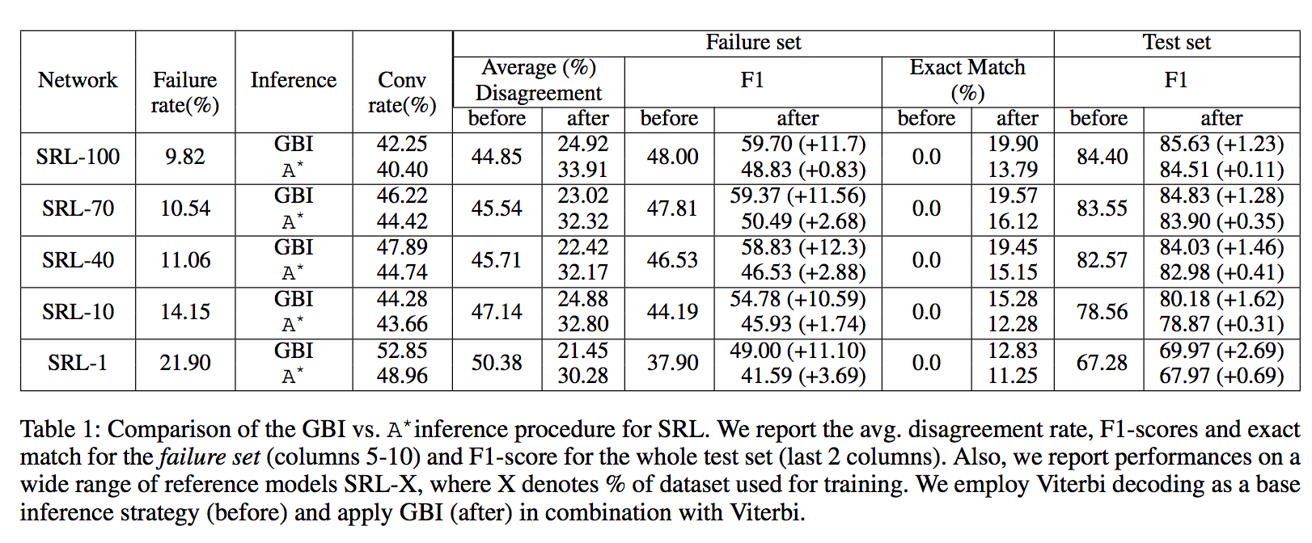
[backup] SRL full result
Notes:
Throw in some neural network equations h_t = f(W*x_t)

Slide 107
[backup] SRL using off-the-shelf parser
Notes:
Throw in some neural network equations h_t = f(W*x_t)

Slide 108
[backup] SRL full result
Notes:
Throw in some neural network equations h_t = f(W*x_t)

Slide 109
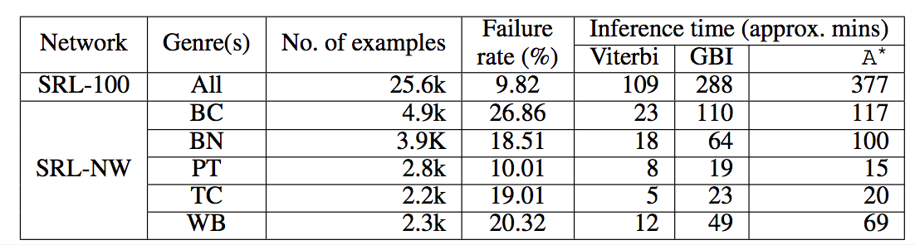
[backup] Time
Notes:
Throw in some neural network equations h_t = f(W*x_t)

Slide 110
Robustness of GBI
SRL has about 10% of the span mismatch between annotated SRL output (propbank) & parse tree (treebank)
Notes:
Throw in some neural network equations h_t = f(W*x_t)

Slide 111
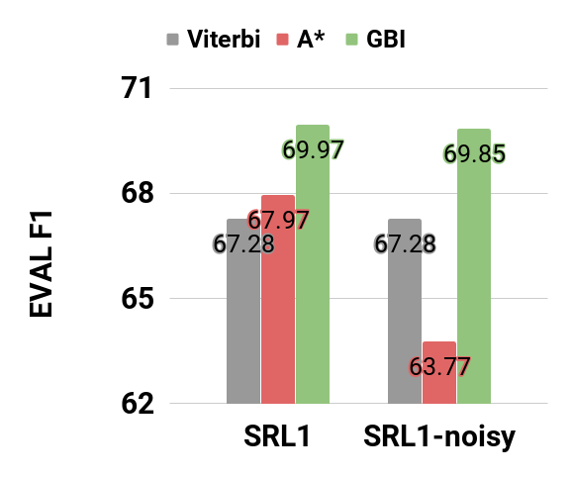
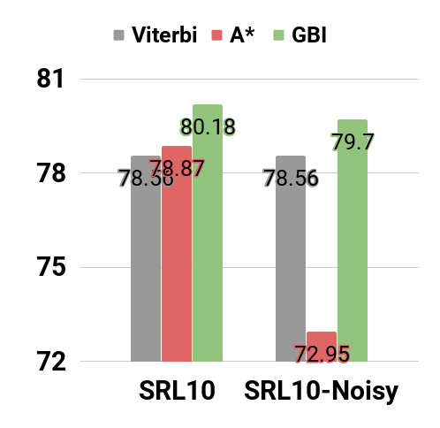
Robustness of GBI
SRL has about 10% of the span mismatch between annotated SRL output (propbank) & parse tree (treebank)
1% - trained
10% - trained
Notes:
Throw in some neural network equations h_t = f(W*x_t)

Slide 112
Robustness of GBI
SRL has about 10% of the span mismatch between annotated SRL output (propbank) & parse tree (treebank)
1% - trained
10% - trained
Noise hurts A* but not much on GBI
Notes:
GBI not only works better than A*
It is far more robust than A*

Slide 113
Key Idea for the method
Can we nudge the model parameter W
to search constraint-satisfying output y?
Model parameter W is in continuous space.
W can be updated with “some” loss function.
Change of thought:
Model parameter update are done in training.
But, can we update model parameter to “search” in inference time?
Category | Method | Complexity | e.g.) SRL (T=7, V=130)
Train | W update | O(TLh²) | 700k
Inference | Combinatorial search | O(V^{T}) | 6.27E+14
Proposed inference | Search Y by updating W (with greedy) | O(TV) + O(TLh²) | 0.9k + 700k (E+5)
 | Search Y by updating W (with Viterbi) | O(TV²) + O(TLh²) | 110k + 700k (E+5)
Notes:
If we can create a loss function to decrease the “cosntraint violation”,
Could we perhaps get the constraint satisfying output more efficiently?

Slide 114
GBI on transducer (sequence-to-sequence)
Transduction (toy)
A transducer (T) is a function from a ‘source language’ (L_{s} ) to a ‘target language’ (L_{T} ).
T: az → aaa
bz → zb
S: azazbzazbzbzazbzbzbzbzbz
T: aaaaaazbaaazbzbaaazbzbzbzbzb
constraint:
3 x (# a in S) = # a in T
Notes:
Even this simplistic constraint work.
The training set comprises 1934 sequences of length 2–20 and the test set contain sentences of lengths 21-24.
network fails to learn this constraint because doing so would require counting and memo- rizing the number of input a0s over long sequences of characters.

Slide 115
GBI on transducer (sequence-to-sequence)
Transduction (toy)
A transducer (T) is a function from a ‘source language’ (L_{s} ) to a ‘target language’ (L_{T} ).
T: az → aaa
bz → zb
Experiment Result
65.2% conversion rate
On Failure set (accuracy)
Before-GBI: 75.2%
After-GBI: 82.4%
S: azazbzazbzbzazbzbzbzbzbz
T: aaaaaazbaaazbzbaaazbzbzbzbzb
constraint:
3 x (# a in S) = # a in T
Notes:
Even this simplistic constraint work.
The training set comprises 1934 sequences of length 2–20 and the test set contain sentences of lengths 21-24.
network fails to learn this constraint because doing so would require counting and memo- rizing the number of input a0s over long sequences of characters.

Slide 116
GBI on transducer (sequence-to-sequence)
Transduction (toy)
A transducer (T) is a function from a ‘source language’ (L_{s} ) to a ‘target language’ (L_{T} ).
T: az → aaa
bz → zb
Experiment Result
65.2% conversion rate
On Failure set (accuracy)
Before-GBI: 75.2%
After-GBI: 82.4%
S: azazbzazbzbzazbzbzbzbzbz
T: aaaaaazbaaazbzbaaazbzbzbzbzb
constraint:
3 x (# a in S) = # a in T
Notes:
Even this simplistic constraint work.
The training set comprises 1934 sequences of length 2–20 and the test set contain sentences of lengths 21-24.
network fails to learn this constraint because doing so would require counting and memo- rizing the number of input a0s over long sequences of characters.

Slide 117
GBI on parsing (sequence-to-sequence)
Syntactic Parsing
Finding structure of the provided (input) sentence.
Parser
John has a dog
True output:
(S (NP xx) (VP xx(NP xx xx))
Constraint:
“# open - # closing bracket = 0”
“# of input tokens has to match # of children on the tree”
Others:
(S (NP xx) (VP xx (NP xx xx) ) ) ) )
( (S (NP xx) (VP xx (NP xx xx) )
(S (NP xx) ) )(VP xx (NP xx xx) ) )
(S (NP xx xx xx xx xx))
(S (NP xx) (VP xx xx xx))
Notes:
Open, close are ”balanced” and
Input tokens being “preserved”

Slide 118
GBI on parsing: Experiments
Trained 5 parsers to answer Q1-4 (especially Q3)
Net1-2: GNMT (bi-directional encoder, uni-directional decoder)
Net3-5: uni-directional encoder, decoder.
Different dropout, used different portion of the dataset.
GNMT: Wu et al, Google's Neural Machine Translation System: Bridging the Gap between Human and Machine Translation, 2016
Notes:
A bit of explanation on imitation learning

Slide 119
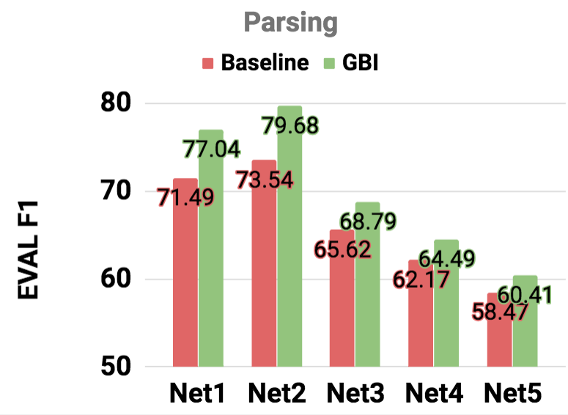
GBI on parsing (sequence-to-sequence)
Notes:
A bit of explanation on imitation learning

Slide 120
Constraints function
Rules
# of input tokens = # of children on output tree
# opening brackets = # of closing brackets
Constraint function definition (x:input, y: output)
Simple count of errors normalized by sum of input, output length.
Roughly speaking:
Notes:
(S (NP xx) (VP xx(NP xx xx))

Slide 121
Constraints function
Rules
# of input tokens = # of children on output tree
# opening brackets = # of closing brackets
Constraint function definition (x:input, y: output)
Simple count of errors normalized by sum of input, output length.
Roughly speaking:
Normalizaiton
Preservation of # of tokens
between input & output.
Balancing
brackets
Notes:
(S (NP xx) (VP xx(NP xx xx))

Slide 122
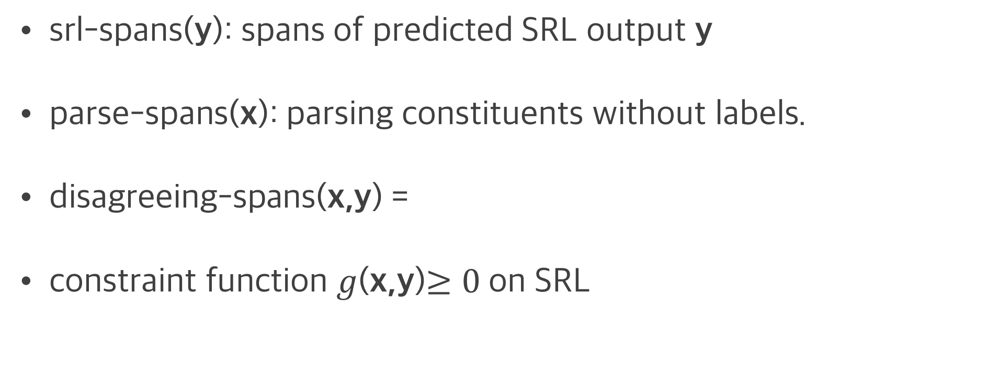
Constraint function g on SRL
srl-spans(y): spans of predicted SRL output y
parse-spans(x): parsing constituents without labels.
disagreeing-spans(x,y) =
constraint function $g$(x,y)$≥0$on SRL
Notes:
In the QA

Slide 123
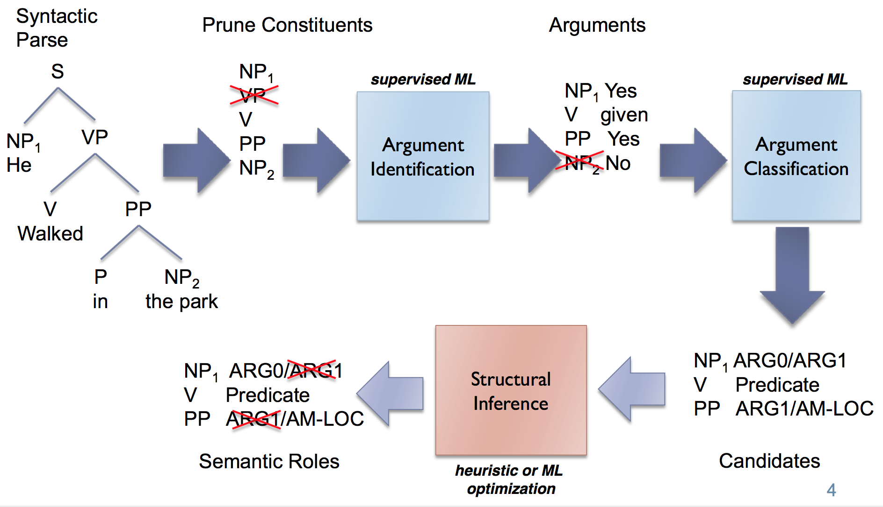
Constraint on SRL
Constraint (violation) scores on previous exmaple
Possible span candidate
(He), (walked), (in the park),
(walked in the park), (He walked in the park)
X (Input )
“He walked in the park”
g(x,y)
0.0
0.33
0.5
1.0
0.0
(He) (walked) (in the park)
(He) (walked in)(the park)
(He walked) (in the park)
(He walked in the)(park)
(He walked in the park)
Assign scores to the constraint- violating output
Y (output)
VERB – walked
ARG0 – He
LOC– in the park

Slide 124
[Backup] A* algorithm
If we use “admissible heuristic function”:
Admissible: never overestimates the cost of reaching the goal
g(n) <= g*(n), where
f(n) = g(n) + h(n)
f: evaluation function
g(n): heuristic function (estimated cost from current node $n$ to goal)
g*(n): optimal cost to reach a goal from node $n$.
h: the cost from the start node to the current node.
Then A* is
Complete: Finds a path if one exists
Optimal: Finds the shortest.

Slide 125
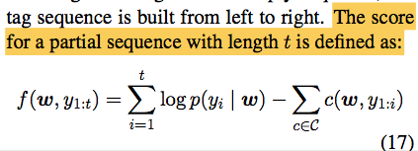
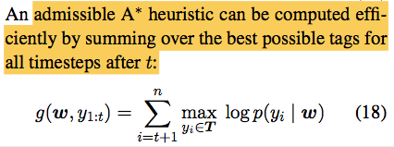
[Backup] A* algorithm
For max cost searching
If we use “admissible heuristic function”:
Admissible: never overestimates the cost of reaching the goal
g(n) <= g*(n), where
f(n) = g(n) + h(n)
f: evaluation function
g(n): heuristic function (estimated cost from current node $n$ to goal)
g*(n): optimal cost to reach a goal from node $n$.
h: the cost from the start node to the current node.
Then A* is
Complete: Finds a path if one exists
Optimal: Finds the shortest.
>=
If there is no constraint violation, g(n)=g*(n)
If there is constraint violation, g(n)>g*(n)
g(n) is admissible!

Slide 126
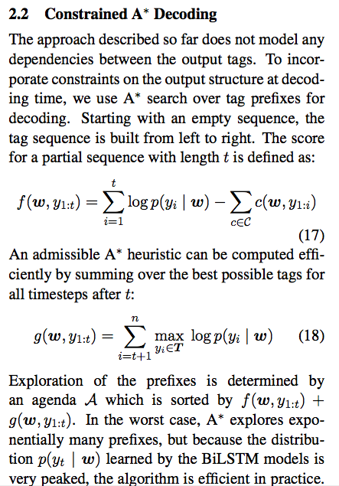
[Backup] A* algorithm
If we use “admissible heuristic function”:
Admissible: never overestimates the cost of reaching the goal
h(n) <= h*(n), where
f(n) = h(n) + g(n)
f: evaluation function
h(n): heuristic function (estimated cost from current node $n$ to goal)
h*(n): optimal cost to reach a goal from node $n$.
g: the cost from the start node to the current node.
If h(x)<=d(x,y)+h(y)
Then A* is
Complete: Finds a path if one exists
Optimal: Finds the shortest.

Slide 127
GBI on out-of-domain data (Q5)
CoNLL2012
NewsWire (NW)
Broadcast Conversation (BC)
Broadcast News (BN)
Pivot Corpus (PT)
Telephone Conversation (TC)
Weblogs (WB)
Notes:
Throw in some neural network equations h_t = f(W*x_t)

Slide 128
GBI on out-of-domain data
Source
Domain
CoNLL2012
NewsWire (NW) which includes WSJ
Broadcast Conversation (BC)
Broadcast News (BN)
Pivot Corpus (PT)
Telephone Conversation (TC)
Weblogs (WB)
Constraint
Target
Domain
IMPROVED!
Can constraint injection
transfer to other domains?
Notes:
Throw in some neural network equations h_t = f(W*x_t)

Slide 129
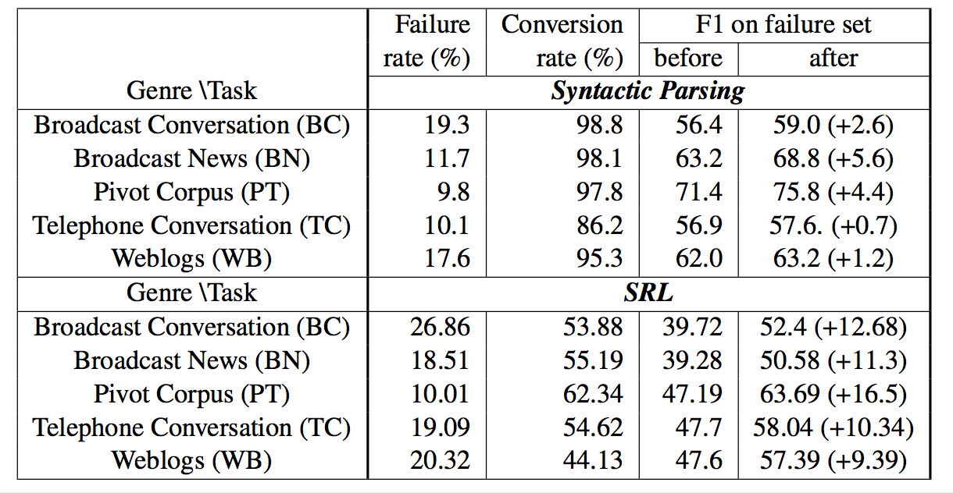
GBI on out-of-domain data
Generally higher failure rate on out-of-domain evaluation compared to in-domain (parsing: 11.9 %, SRL: 18.1%).
Notes:
Throw in some neural network equations h_t = f(W*x_t)

Slide 130
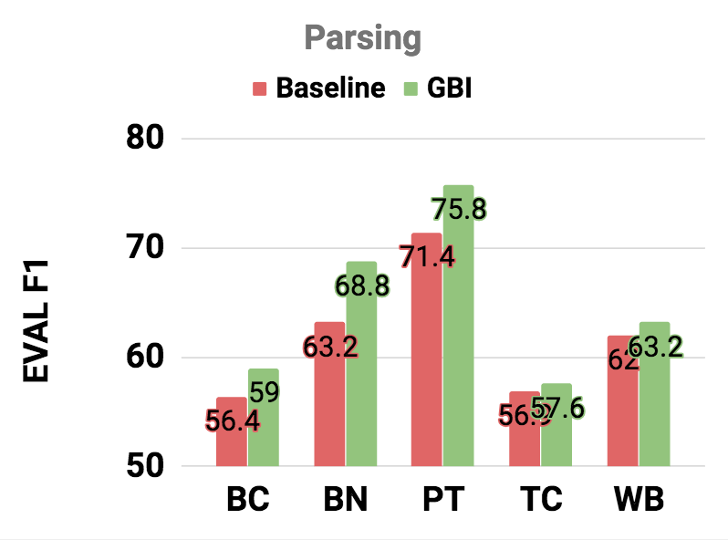
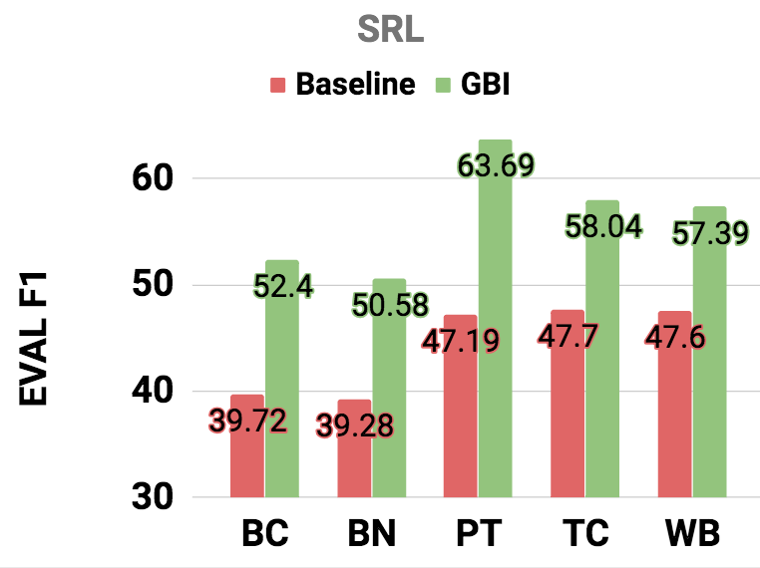
GBI on out-of-domain data
In summary, improves in all cases (reporting on failure set)
While parsing is more sensitive to domains.
Notes:
Throw in some neural network equations h_t = f(W*x_t)

Slide 131
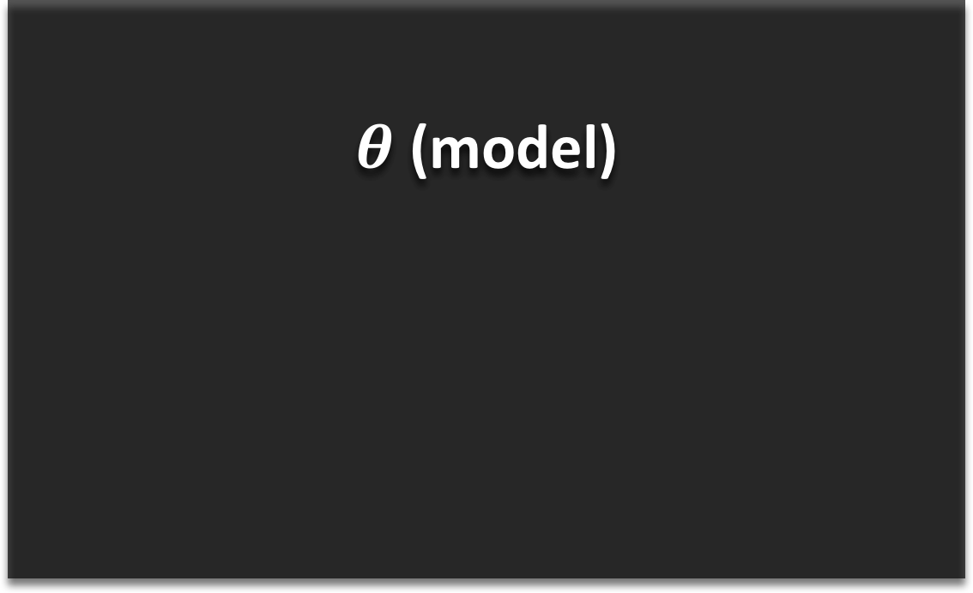
[Revisit] SRL architecture
Semantic Role Labeling
$θ$ (model)
X (Input )
The cat
loves hats
Y (output)
VERB – love
ARG0 – the cats
ARG1– hats
Slide credits: Luheng He

Slide 132
How to express the Grammar Tree as a sequence?
Proposed model
“As a command” to produce the tree.
Shift-Reduce syntax
Bottom-up approach
Similar to how human minds work.
S
NP
VP
.
John
has
NP
a
dog

Slide 133
How to express the Grammar Tree as a sequence?
S
Proposed model
NP
VP
“As a command” to produce the tree s R-1-NP s s s R-2-NP R-2-VP R-2-S
Shift-Reduce syntax
s corresponds to “push” in stack.
R-#-XX corresponds to “pop”-ing that # of elements , merging them together to XX, and pushing it back to the stack.
John
has
NP
a
dog
Notes:
I am going to show an example of shift-reduce syntax
But without all the details, the take away from here is that you can linearize the parse tree
Into corresponding shift-reduce commands.

Slide 134
GBI on
GBI case study

Slide 135
Case study of GBI on parsing
Comparison to decoder with constraints on each step.
Unconstrained decoding + Error signal propagation can be more powerful.
Notes:
(S (NP xx) (VP xx(NP xx xx))

Slide 136
GBI extra experiment
SRL has the following constraints
BIO – captured by vitrebi
Syntactic consistency
U,C,R violation
Unique core (U) / Continuation (C) / Reference (R) roles
SOTA models have UCR violations
GBI successfully reduces U,C,R violations.
No F1 score improvement, but the side effect of U,C,R is still unstudied as SRL output is used as an input to the following system.
Notes:
0.11-0.69
1.23-2.69

Slide 137
GBI on Transduction
Case study of GBI on transduction problem.
Notes:
Throw in some neural network equations h_t = f(W*x_t)

Slide 138
GBI on
GBI in detail

Slide 139
Gradient-Based Inference (GBI)
Motivation
Optimization with constraints
Standard Lagrangian Relaxation
Modified Lagrangian Relaxation
Likelihood
Constraint violation
Notes:
Constraints that are not localized.

Slide 140
Gradient-Based Inference (GBI)
Motivation
Standard Lagrangian Relaxation
Gradient-Based Inference
Notes:
change it to intuition
Proposed model

Slide 141
Gradient-Based Inference (GBI)
Motivation
Modified Lagrangian Relaxation
Gradient-Based Inference
Notes:
Throw in some neural network equations h_t = f(W*x_t)

Slide 142
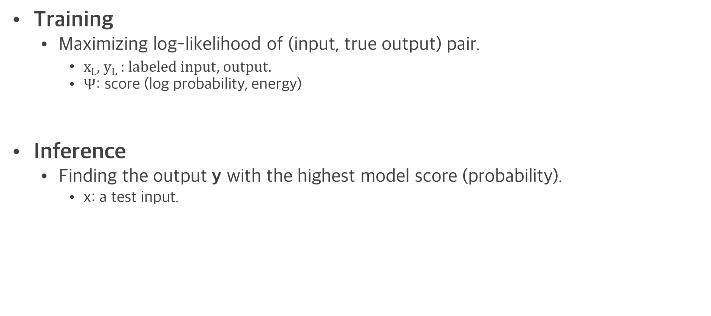
Training & Inference of a neural model
y (output)
model
(W)
Training
Maximizing log-likelihood of (input, true output) pair.
x_{L}, y_{L} : labeled input, output.
$Ψ$: score (log probability, energy)
Inference
Finding the output y with the highest model score (probability).
x: a test input.
Learned model
x (Input )
Notes:
Let’s discuss “inference” of sequence output Y in general for a moment.

Slide 143
Inference on sequence output
x (Input )
y (output)
x₁
x₂
x₃
x_{K}
y₁
y₂
y₃
y_{T}
…
…
Notes:
V dimensional P1 probability vector for tagging X1,

Slide 144
Inference on sequence output
x₁
x₂
x₃
x_{K}
y₁
y₂
y₃
y_{T}
Probability vectors
on output space
{O₁, O₂,..., O_{V}}
…
…
Notes:
P1 for output Y1, P2 for output Y2, And till PT
V-possible discrete outputs O1....Ov

Slide 145
Inference on sequence output
V
x₁
x₂
x₃
x_{K}
P₁(O₁) P₁(O₂) … P₁(O_{V})
y₁
y₂
y₃
y_{T}
P₂(O₁) P₂(O₂) … P₂(O_{V})
P₃(O₁) P₃(O₂) … P₃(O_{V})
Inference
…
…
…
P_{T}(O₁) P_{T}(O₂) … P_{T} (O_{V})
Notes:
If there is no relation between output to be modeled
Or “if there is no constraint”
However, if there is a relation

Slide 146
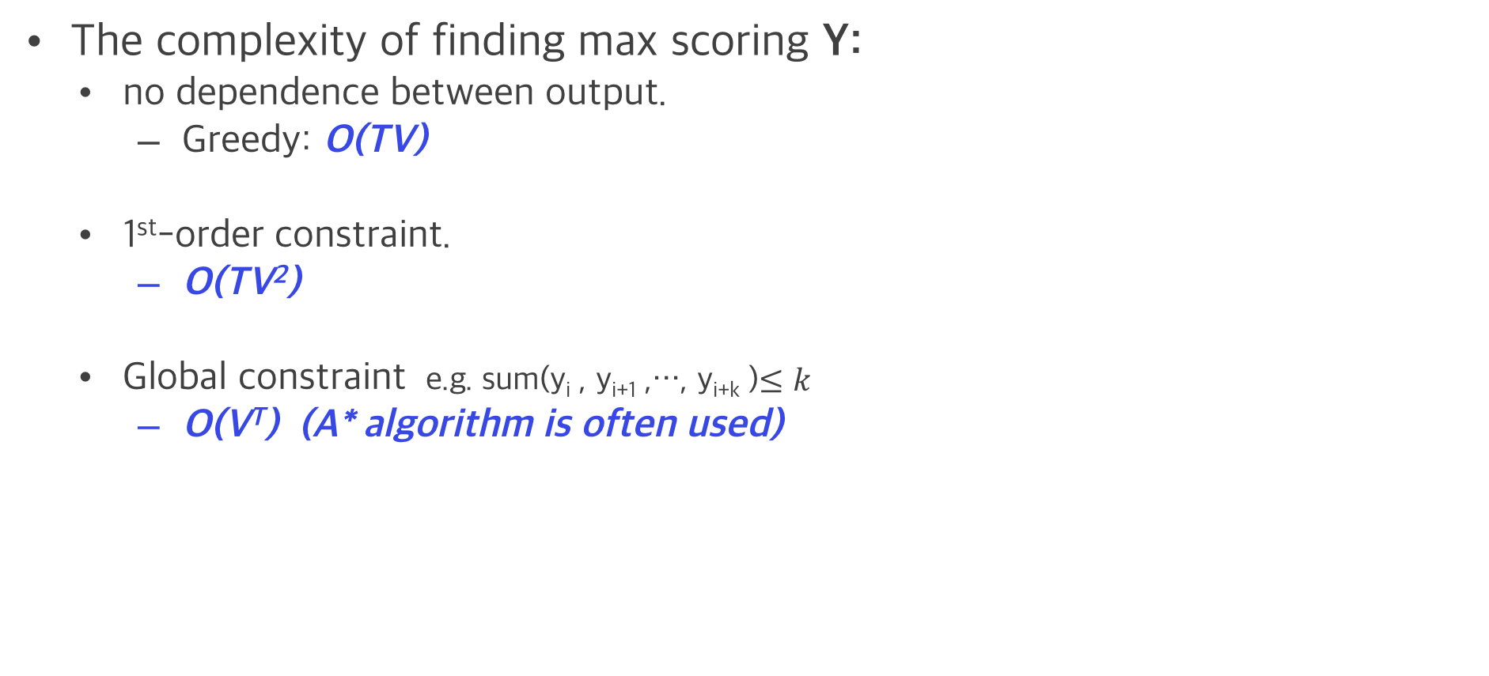
Inference on sequence output
The complexity of finding max scoring Y:
no dependence between output.
Greedy: O(TV)
1st-order constraint.
O(TV²)
Global constraint e.g. sum(y_{i} , y_{i+1} ,…, y_{i+k} )$≤k$
O(V^{T}) (A* algorithm is often used)
V
P₁
P₂
P₃
P_{T}
P₁(O₁) P₁(O₂) … P₁(O_{V})
y₁
y₂
y₃
y_{T}
P₂(O₁) P₂(O₂) … P₂(O_{V})
T
P₃(O₁) P₃(O₂) … P₃(O_{V})
Inference
…
…
P_{T}(O₁) P_{T}(O₂) … P_{T} (O_{V})
Notes:
Now, this complexity on global constraint is way too expensive.
In the interest of time, I won’t go into the details of A*. It’s much more efficient than naïve search by using DP, but it still suffers from the exponential complexity.

Slide 147
Inference on sequence output
The complexity of finding max scoring Y:
no dependence between output.
Greedy: O(TV)
1st-order constraint.
O(TV²)
Global constraint e.g. sum(y_{i} , y_{i+1} ,…, y_{i+k} )$≤k$
O(V^{T}) (A* algorithm is often used)
Post-processing is often used instead:
Get multiple candidates and filter out constraint-violating candidates.
Notes:
So people rely on post-processing
Even when combinatorial search performs better.

Slide 148
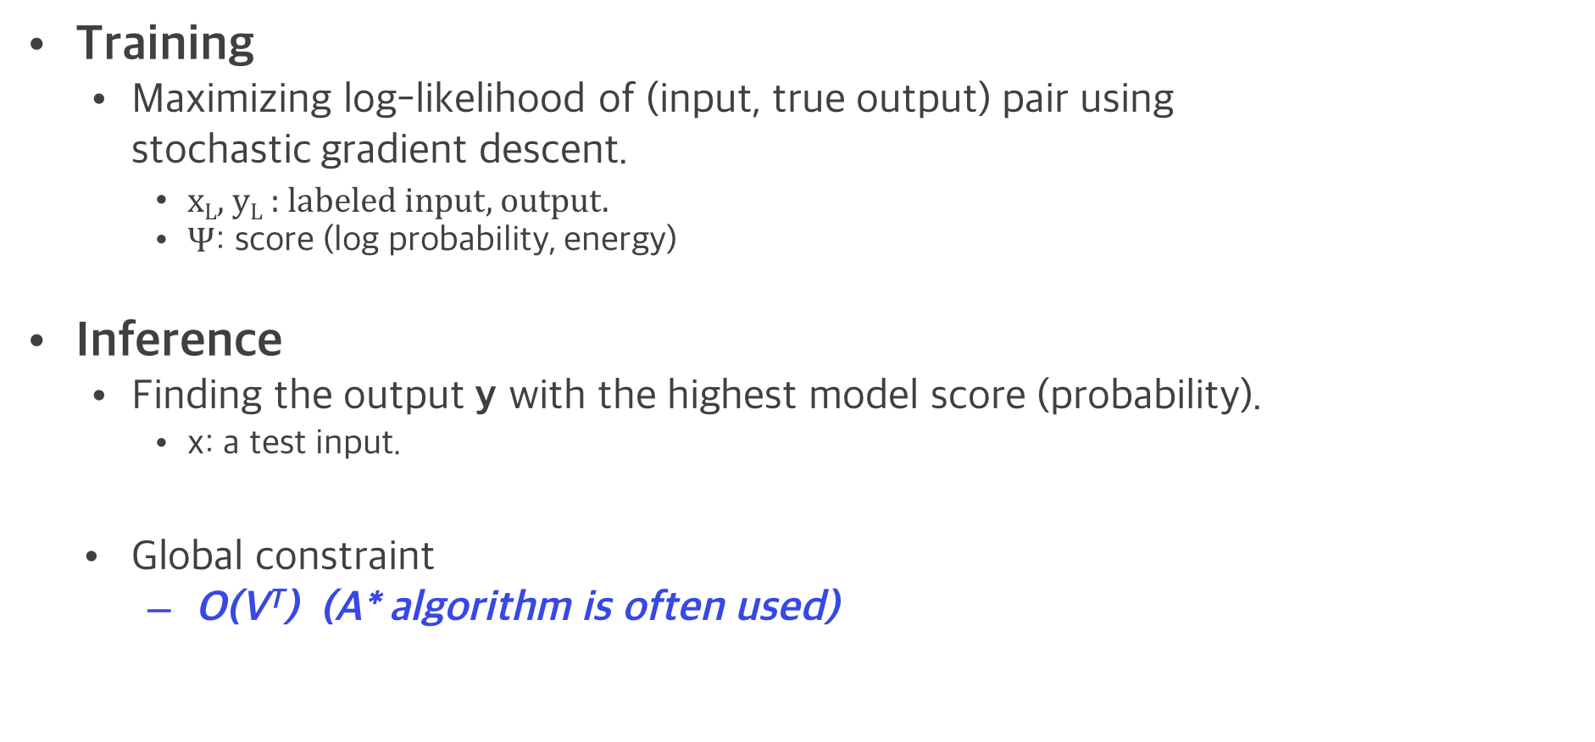
Change of perspective
y (output)
model
(W)
Training
Maximizing log-likelihood of (input, true output) pair using stochastic gradient descent.
x_{L}, y_{L} : labeled input, output.
$Ψ$: score (log probability, energy)
Inference
Finding the output y with the highest model score (probability).
x: a test input.
Global constraint
O(V^{T}) (A* algorithm is often used)
Learned model
x (Input )
Notes:
black box,
because not much of particular modification to the model, Can we update the model parameter to find constraint-satisfying output?
besides input, output representation changes happen in typical neural network training.

Slide 149
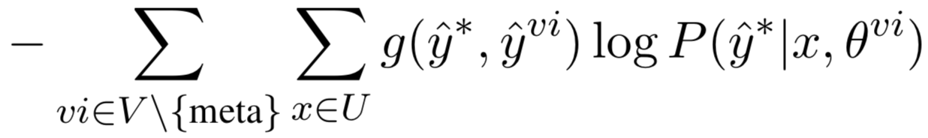
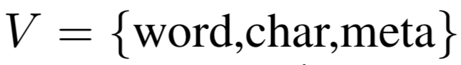
Agreement constraint to promote coherence
Similar to constraint loss definition.
However, rather than comparing to the definitive rule, now we compare each other.
Predicted out for each model
The best possible out given multi-view (ensemble, voting)
A score function to measure “How similar the predictions are” between y* and y^{vi} (If the output is similar then learn more)

Slide 150
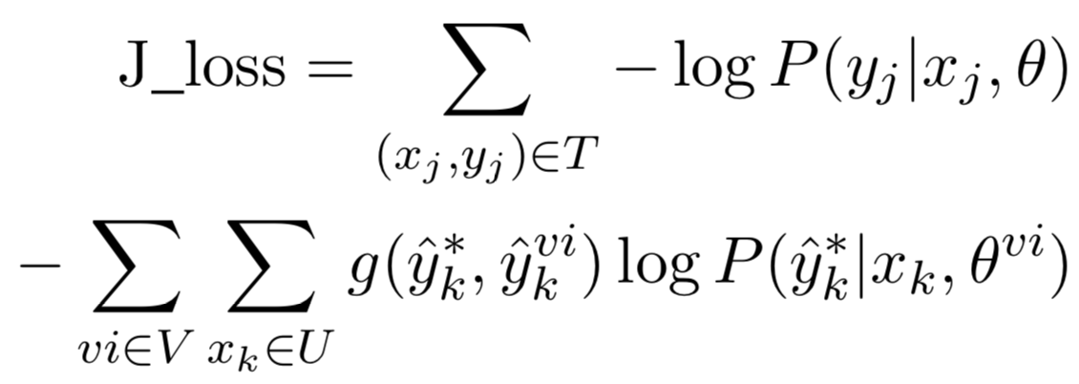
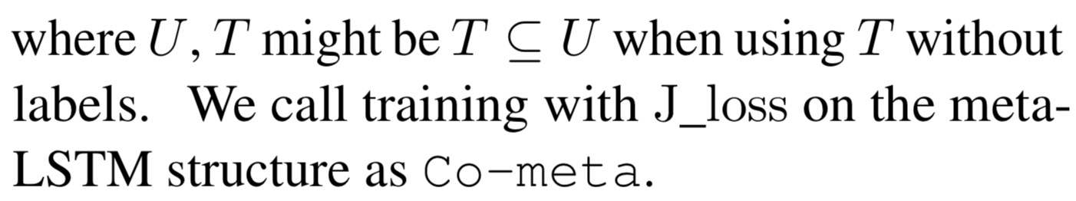
Co-meta overall objective (SSL)
Similar to SSL work with SRL (syntactic constraint injection)
When we have Training set T and Unlabeled set U, our Joint-loss is as:
Supervised
Unsupervised

